Slide 1
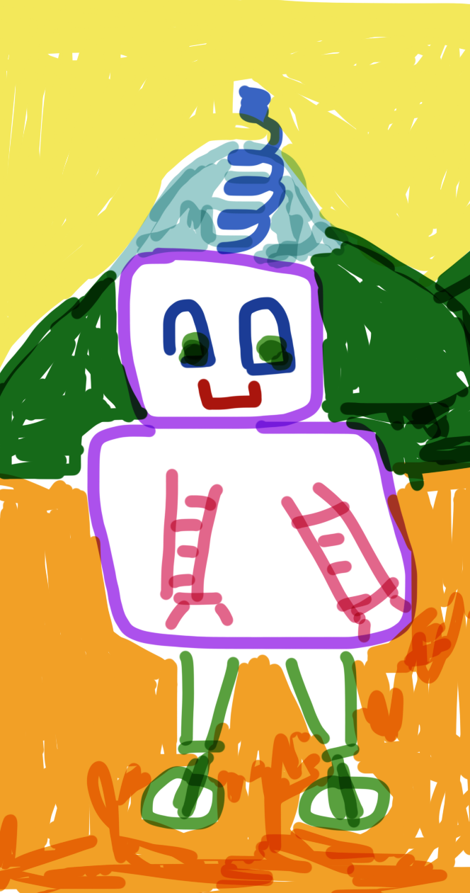
Welcome to Developing and Deploying Intelligent Chat Bots
Day 2
Today’s Agenda
Bot Framework Overview
Bot Framework Developer Introduction and Deploying an Intelligent Bot
Deep Dive into the Microsoft Bot Framework
Be ready for fun labs throughout ☺

Slide 2
Main site: aka.ms/botedu Chat room: aka.ms/botedu-discuss
Notes:
This link contains additional resources on the bot framework and related topics. mailto: michhar<at>microsoft.com for questions/comments. Show sites

Slide 3
Microsoft Bot Framework Overview
Notes:
If the links in this deck are broken please let us know (mailto: michhar<at>Microsoft.com). Thanks in advance and enjoy learning about bots and the Microsoft Bot Framework.

Slide 4
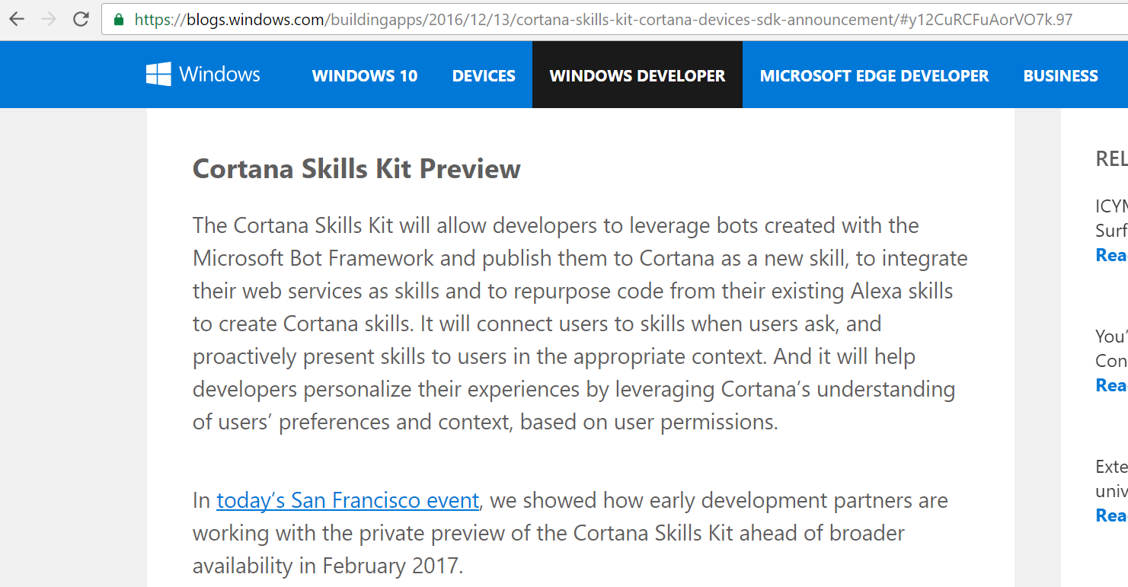
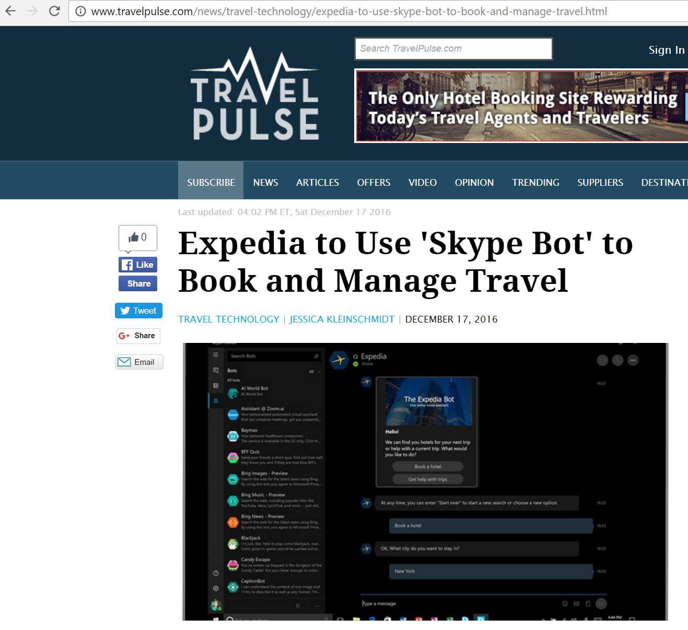
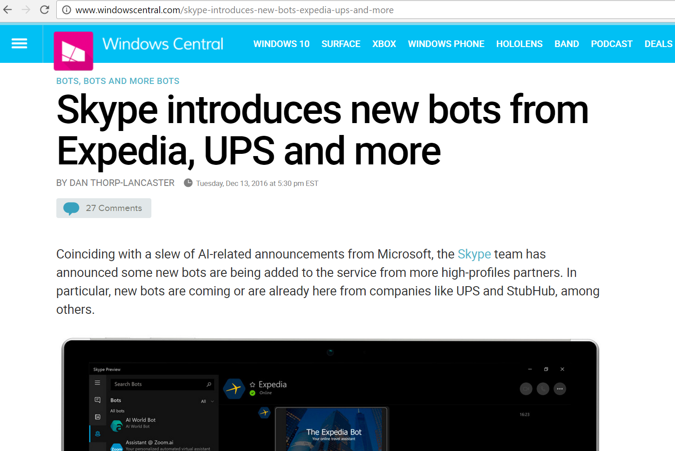
The big deal about “conversation as a platform”
Notes:
http://www.windowscentral.com/skype-introduces-new-bots-expedia-ups-and-more
http://www.travelpulse.com/news/travel-technology/expedia-to-use-skype-bot-to-book-and-manage-travel.html
https://blogs.windows.com/buildingapps/2016/12/13/cortana-skills-kit-cortana-devices-sdk-announcement

Slide 5
Augment human abilities & experiences
Our aims
Trustworthy
Inclusive & respectful

Slide 6
People
Conversation as a Platform
Digital assistants
Bots

Slide 7
Human language is the new UI
Conversation as a Platform
Bots are the new apps; digital assistants are meta apps
Intelligence infused into all interactions

Slide 8
Demo
The ocrbot (Computer Vision bot)
Notes:
Launch the ocrbot from the developer portal using Skype

Slide 9

Session outline
What a bot is and is not
The major components of the Bot Framework
Deploying and working with channels
Your arsenal or toolbox
Dev environment lab
Notes:
Learning objectives for this overview module on the Bot Framework

Slide 10
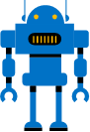
What is a bot?

Slide 11
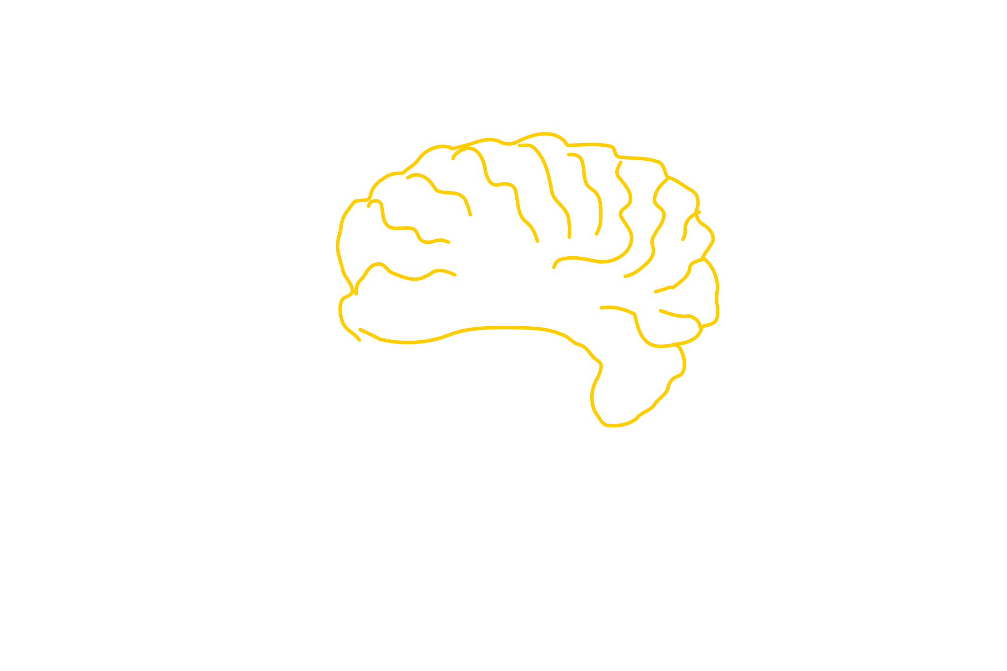
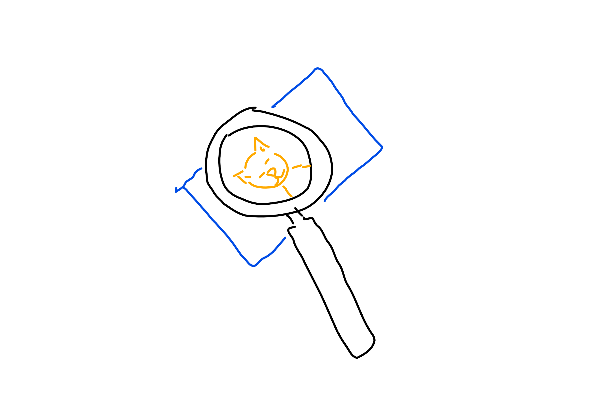
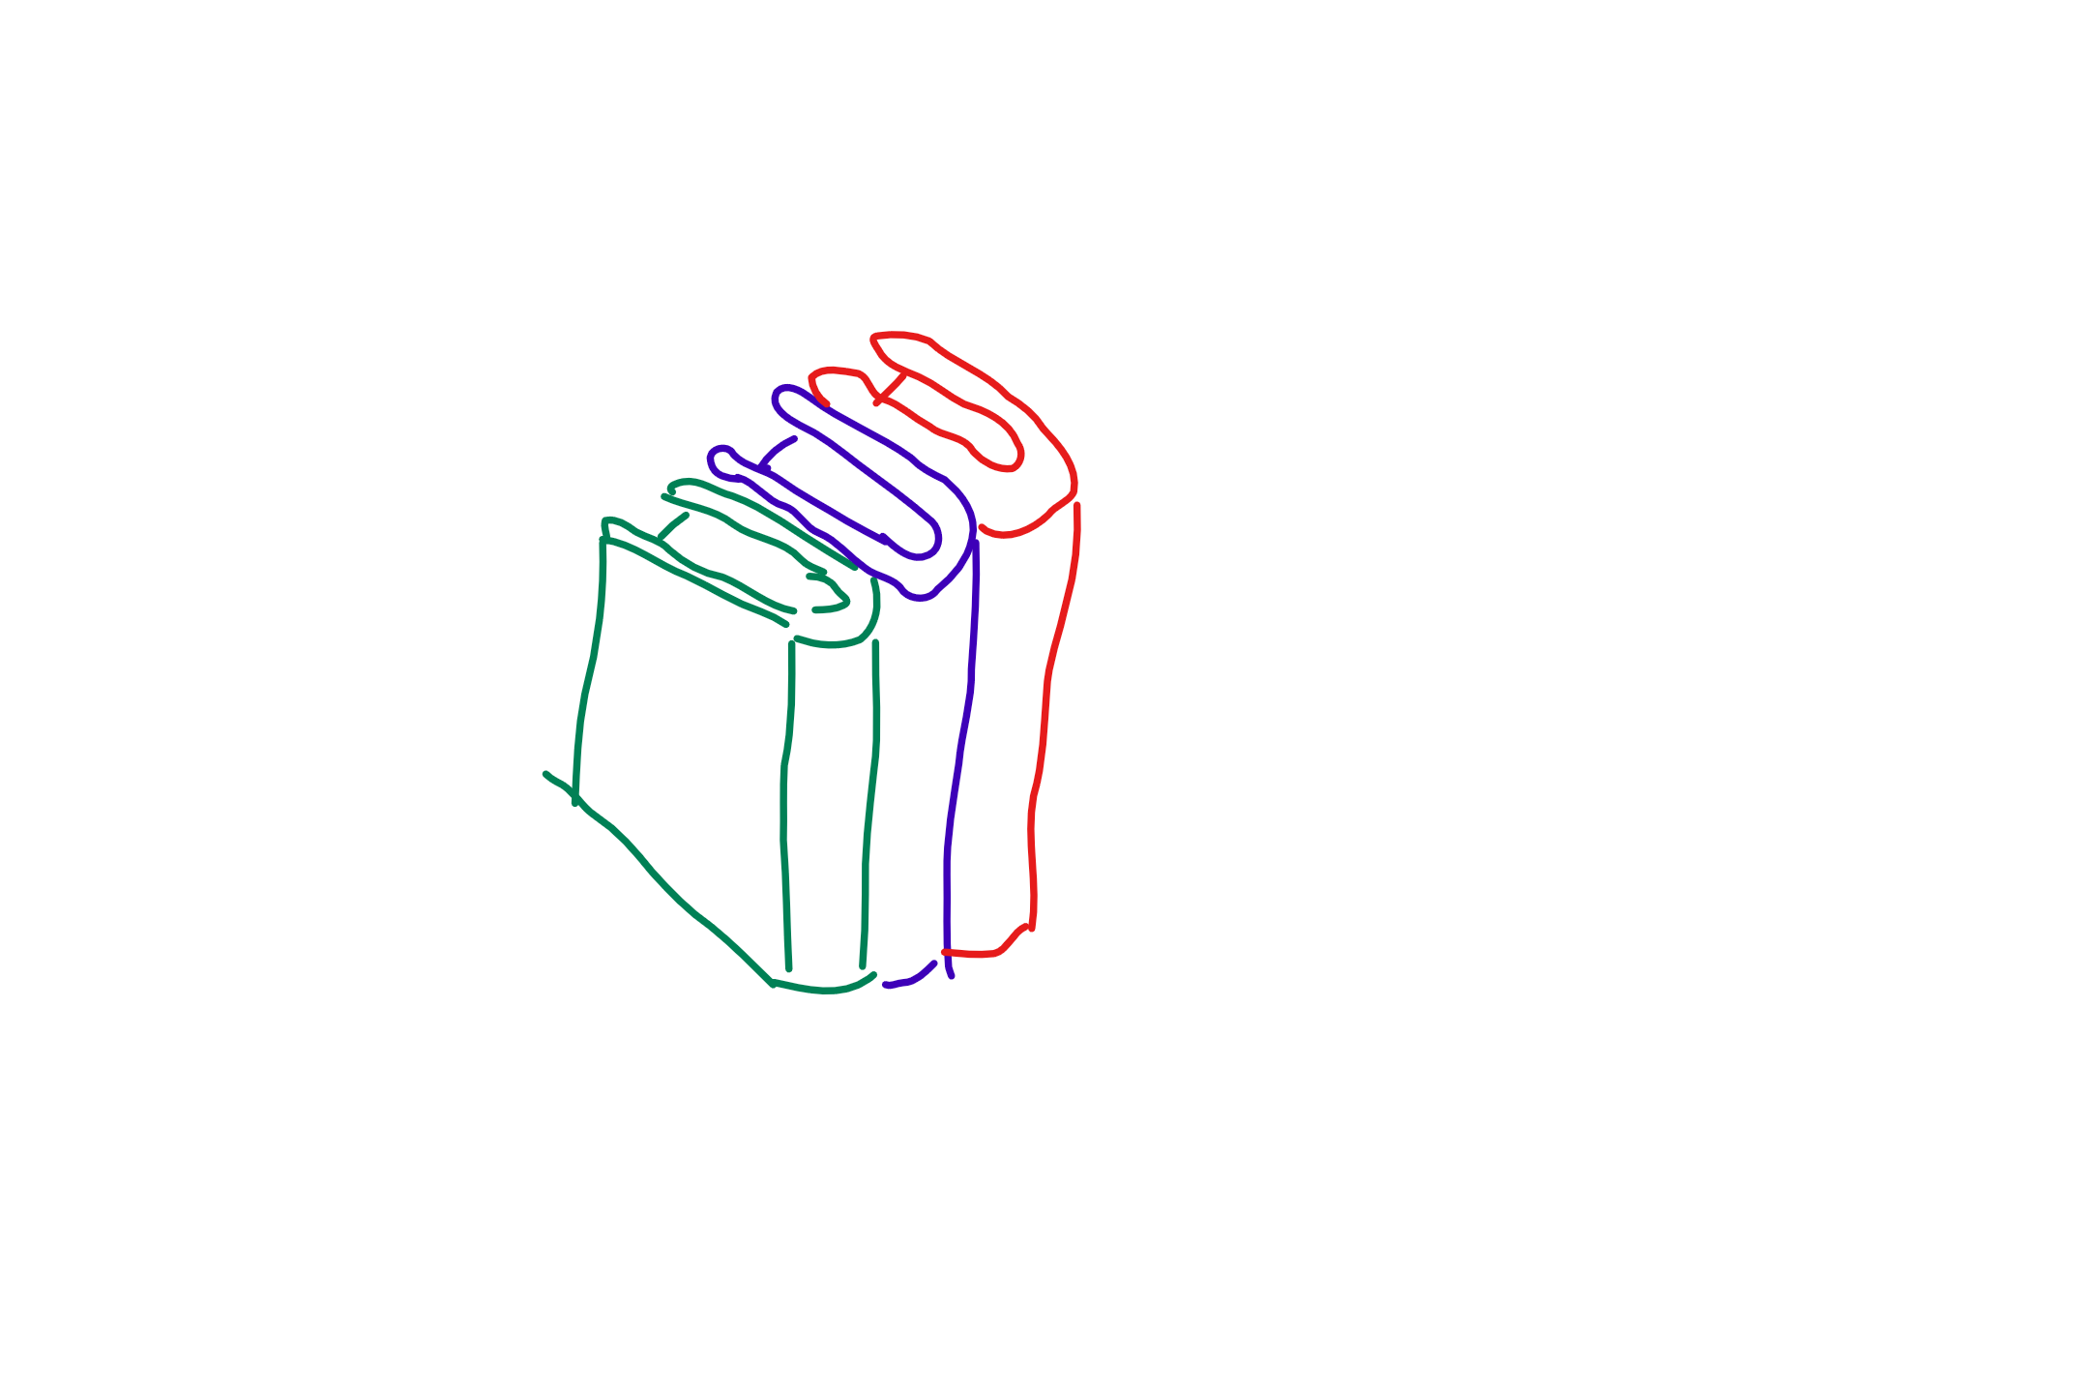
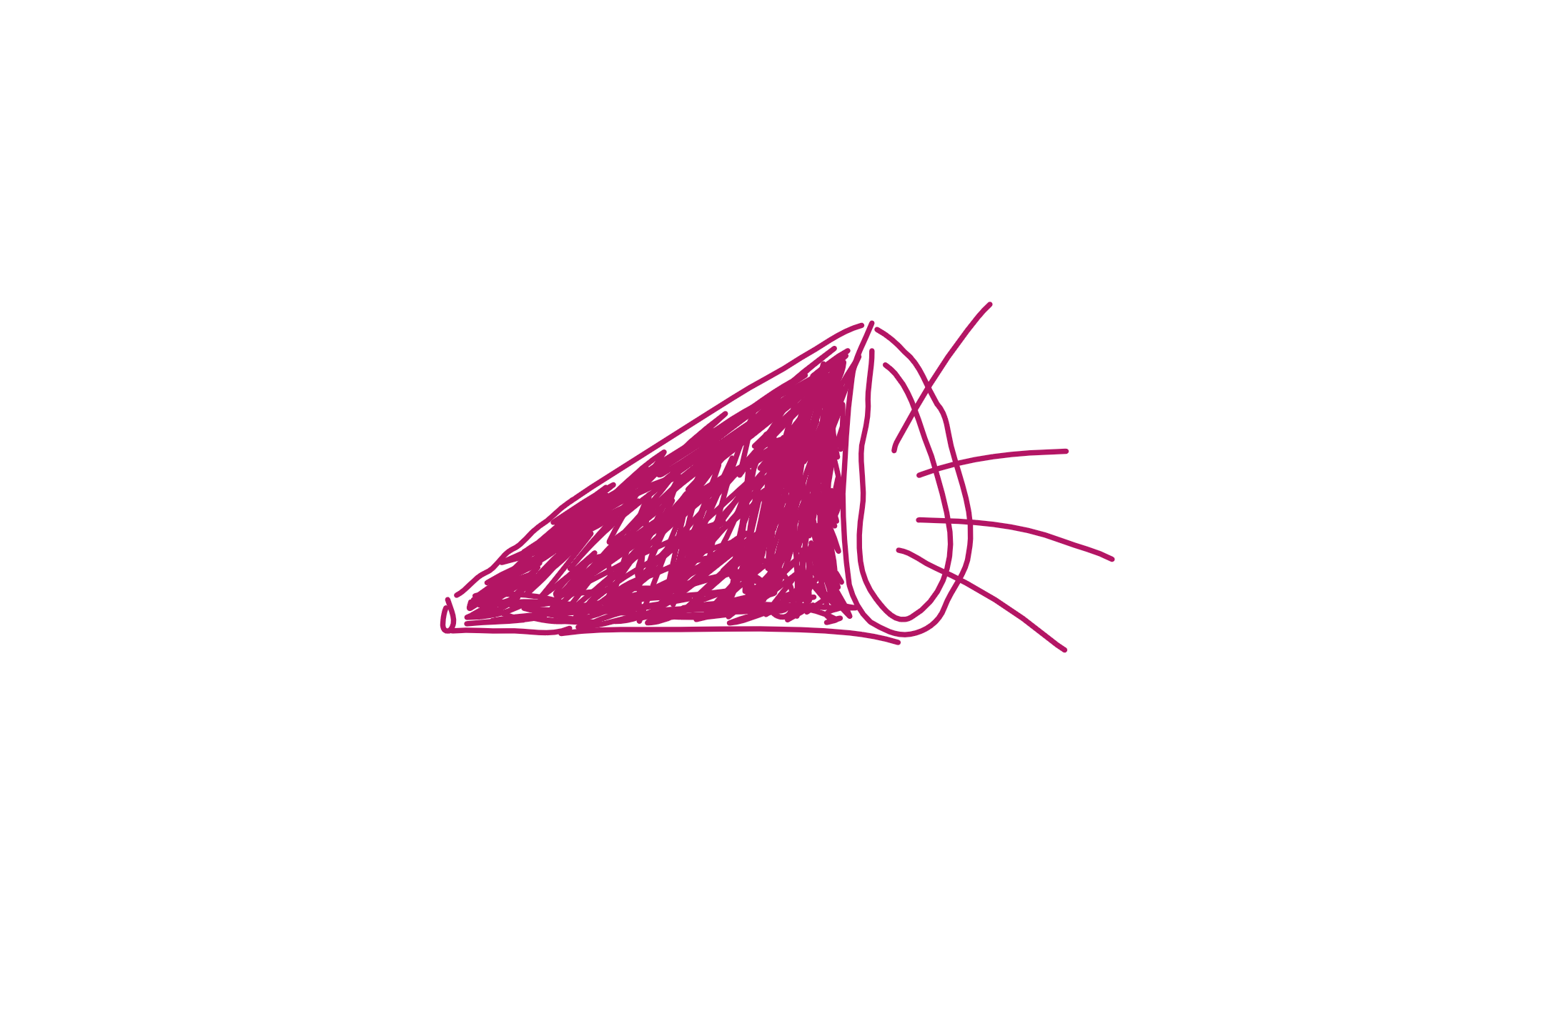
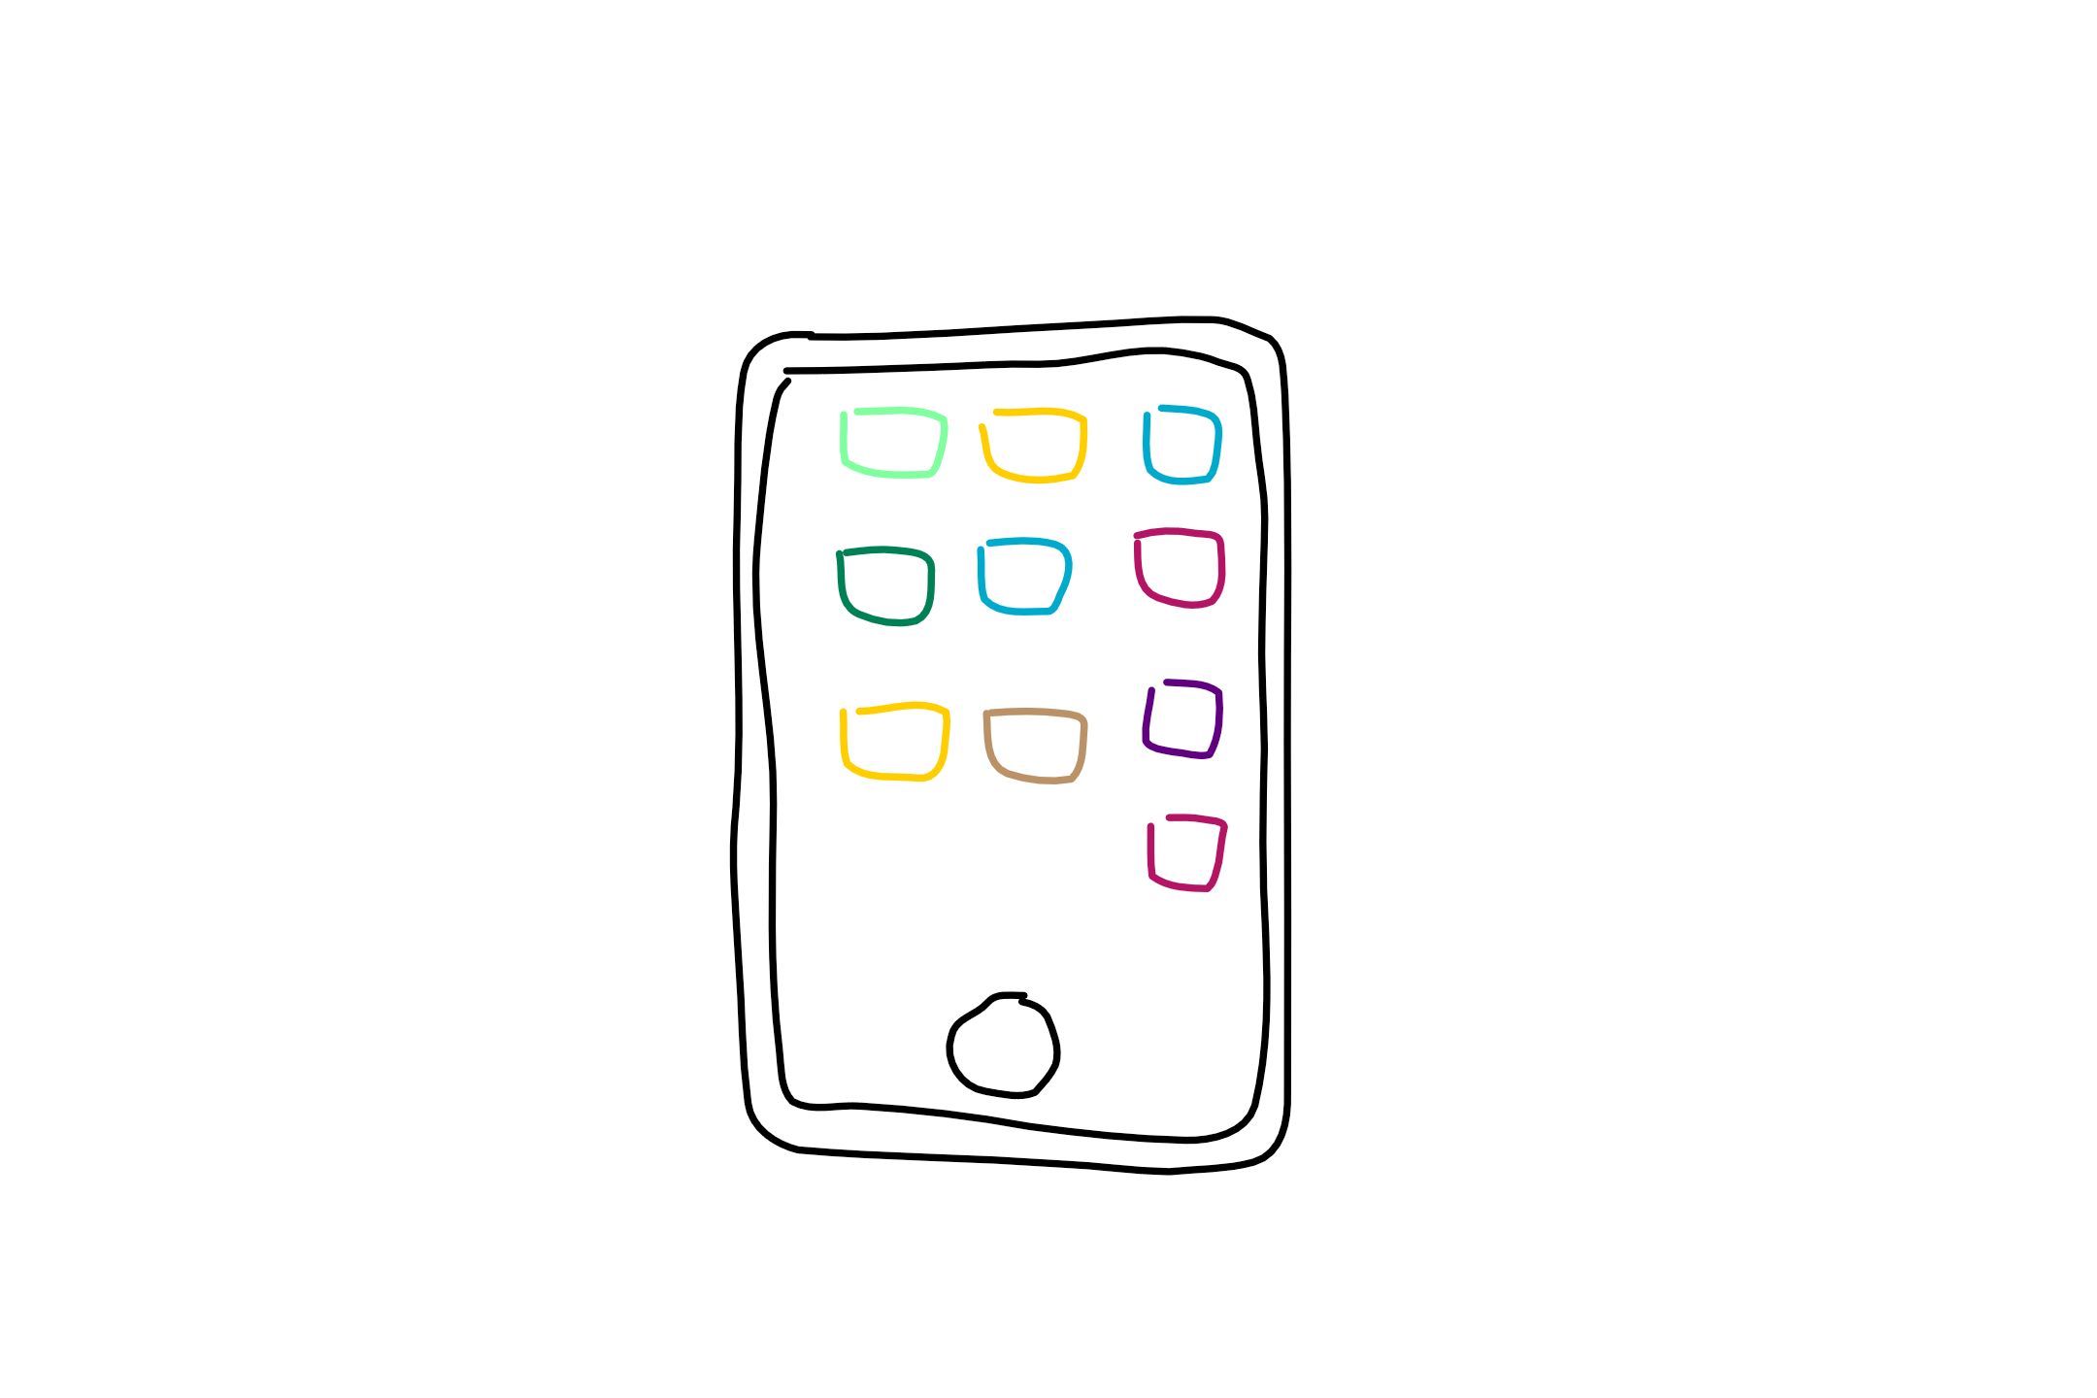
What a bot is not
It’s not AI
It’s not natural language processing only
It’s not text interfaces only
Notes:
Not AI:
Bots can be simple task automation utilities.
Example: Password reset bot. There’s no AI here. Just ask a couple of security validation questions, then reset the password.
They may have AI as well, if the scenario applies
Not only NLP:
Natural language processing has limitations, still. The more your bot depends on NLP, the worse the experience gets. Hint: Typing isn’t always the best option.
Move away from NLP as quickly as possible
“Drive” the user as much as you can (menus, choices, etc). Less typing = better
Not only text interfaces:
Bot channels are evolving quickly to support richer experiences: Media, buttons, custom controls. These are here or on their way. Text is not known to the best experience for everything.
Examples:
Skype allows audio and 3D bots as well.
Slack, Facebook and Skype have buttons/custom UIs

Slide 12
What is a bot?
Simply put, a bot is an application that performs an automated task.
Notes:
Siri, Cortana, the old-school MS Clippy and even AOL’s SmarterChild are some examples. Essentially, bots perform automated tasks that are generally REPETITIVE for humans to do. We want to make life easier for the end user of the bot.
Bots are apps.
They can:
Exist in different channels and across platforms.
Do anything from simple task automation like taking food orders to leveraging sophisticated deep learning algos as is used by CaptionBot (https://www.captionbot.ai/ which describes the contents of an image how a human would) and otherAI-esque capabilities.
What a bot can do is only limited to the APIs your bot uses.
Bots don’t have to leverage the MS Bot Framework (e.g. MimikerAlarm https://www.microsoft.com/cognitive-services/en-us/mimickeralarm, an app for waking you up), but the Framework makes dev and deploy much simpler and faster for.

Slide 13
What types of bots are there?
Notifiers
Reactors
Responders
Conversationalist
Complexity
Notes:
Based on this blog post: http://willschenk.com/bot-design-patterns/?imm_mid=0e50a2&cmp=em-data-na-na-newsltr_20160622 about different bot types and the definitions of these.
Notifier - simply broadcast messages aka push bot e.g. ping me when there's a interesting tweet about Hadley Wickam
Reactor - reacts to messages on service, but doesn’t persist anything (message, user state, location) e.g. send me the stock price for a stock I specify, but don't remember me or what I say
Responder - reacts to messages on service, persists message and knows who I am e.g. send me today's weather forecast for my city, use my user name on this channel, and remember what cities I choose
Conversationalist – reacts to messages, persists messages, knows who I am, knows about the “place” I’m at (channel, room,…), knows the state of the conversation e.g. send me today's weather forecast for a city, use my user name on this channel, remember what cities I choose, format it nicely for this channel, pick up where I left off if I go away for a minute, and if the conversation is very old, archive it and send as email.
From “Bot Design Patterns”: Questions that help us formulate what kind of bot we might want or need:
Do they react to messages?
Do they know who they are talking to?
Can they learn from what was said?
Do they know where the conversation is taking place?
Do they remember the overall conversation?

Slide 14
The bot life cycle
1. Tangible problem
5. Improve on current bot
2. Ask: How is bot better way
4. Collect bot metrics
3. Get around heavy use of NLP
Notes:
Start by asking what problem are we trying to solve. Refine until it looks like a tangible problem and not “magic”
Ask how a bot will be a better experience. User experience is EVERYTHING
Avoid too much natural language. Careful with unrealistic expectations. Natural language recognition is limited. Menus work great. Commands work great. Buttons, etc.
You can only analyze and improve your bot if you’re collecting metrics for it
Iterate, improve

Slide 15
Know the metrics and know the user

Slide 16
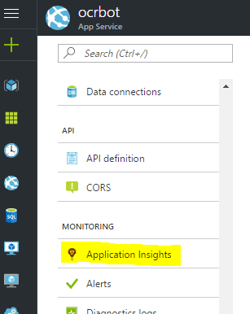
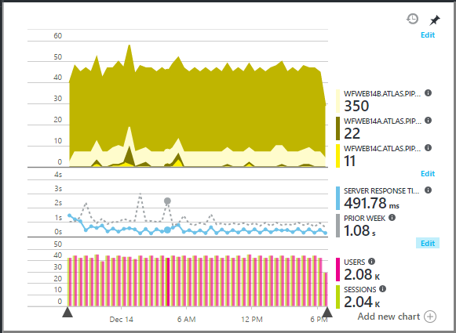
Add Application Insights
In the Azure portal, activate Application Insights for your bot’s web service

Slide 17
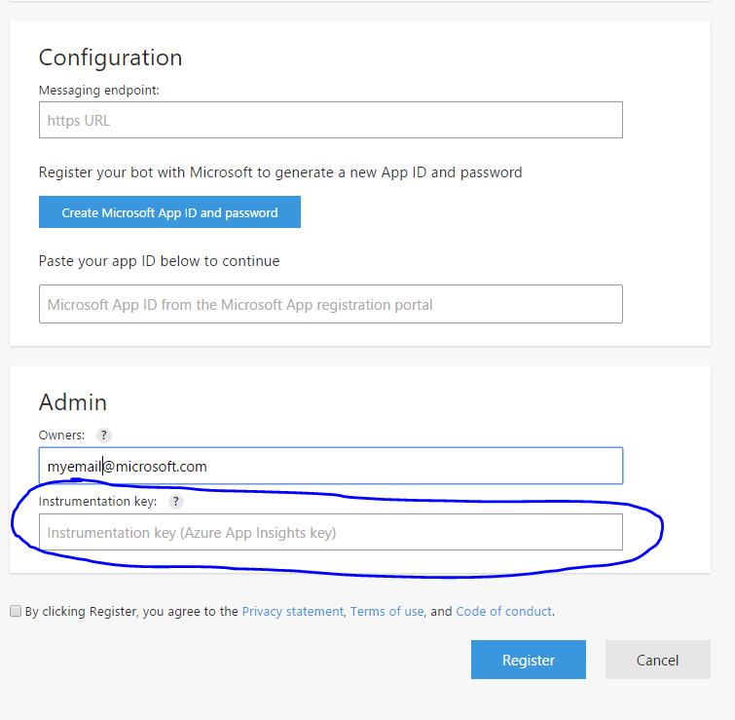
Connect App Insights to the Bot Framework
In the Bot Framework Developer’s portal, plug in your key from App Insights
It’s that easy to collect metrics!

Slide 18
Notes on creating an awesome experience

Slide 19
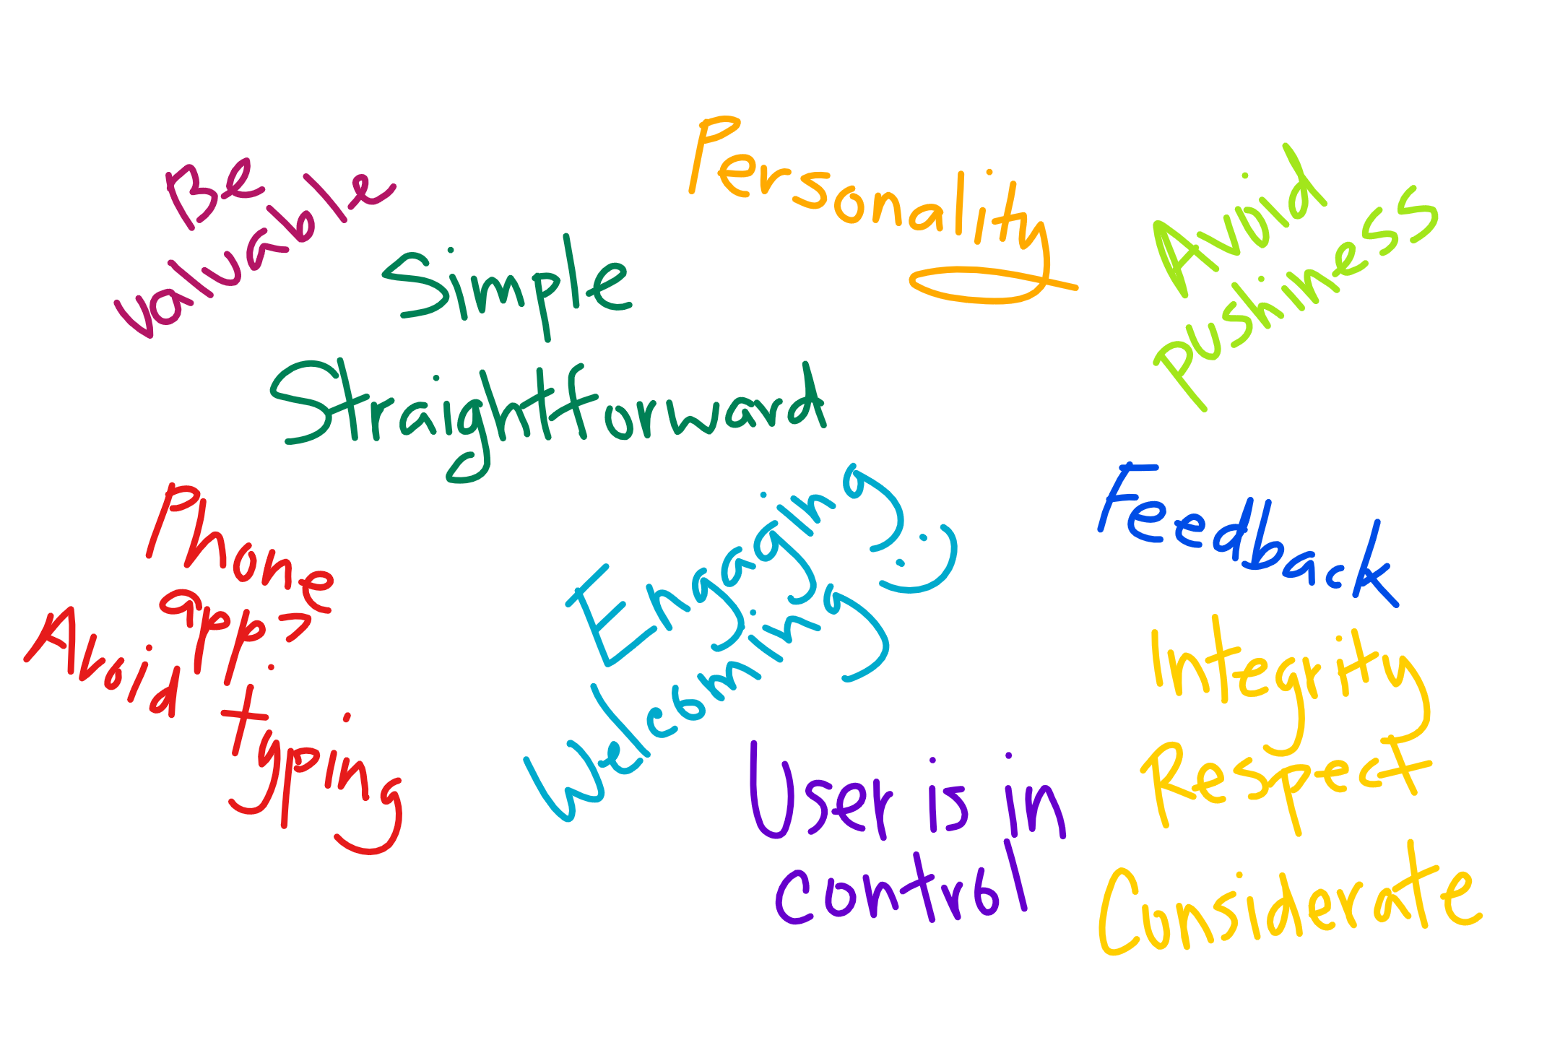
Creating an awesome experience: Aims
Notes:
From: https://docs.botframework.com/en-us/directory/best-practices
This may have been in your mind before this tutorial. Ethical and societal considerations as well in an article by Satya Nadella: https://www.linkedin.com/pulse/partnership-future-how-humans-ai-can-work-together-solve-nadella

Slide 20
Creating an awesome experience: the AI
Key considerations around AI and design today:
Outcomes are determined as much by the human element as by the software element.
The quality of the user experience determines both the usefulness of the product and its rate of adoption, and this is why [it is believed] design is the next frontier of AI.
Notes:
What does this mean?
Credit for paraphrased quotes Manoj Saxena: https://www.fastcodesign.com/3068005/whats-still-missing-from-the-ai-revolution

Slide 21
Here enters the Bot Framework

Slide 22
What is the Bot Framework
A development tool and much more…

Slide 23



Bot Builder SDK
Bot Framework Developer Portal
Bot Directory
Dev
Connect
Publish
Notes:
Bot Builder is itself a framework for building conversational applications (“Bots”).
The Bot Builder SDK is an open source SDK hosted on GitHub that provides everything you need to build great dialogs within your Node.js-, .NET- or REST API-based bot.
The Bot Framework Developer Portal lets you connect your bot(s) seamlessly text/sms to Skype, Slack, Facebook Messenger, Kik, Office 365 mail and other popular services. Register, configure and publish.
The Bot Directory is a public directory of all reviewed bots registered through the Developer Portal.
NB: Bot builder and bot connector SDK now one in V3 of framework: http://docs.botframework.com/en-us/support/upgrade-to-v3/#botbuilder-and-connector-are-now-one-sdk

Slide 24
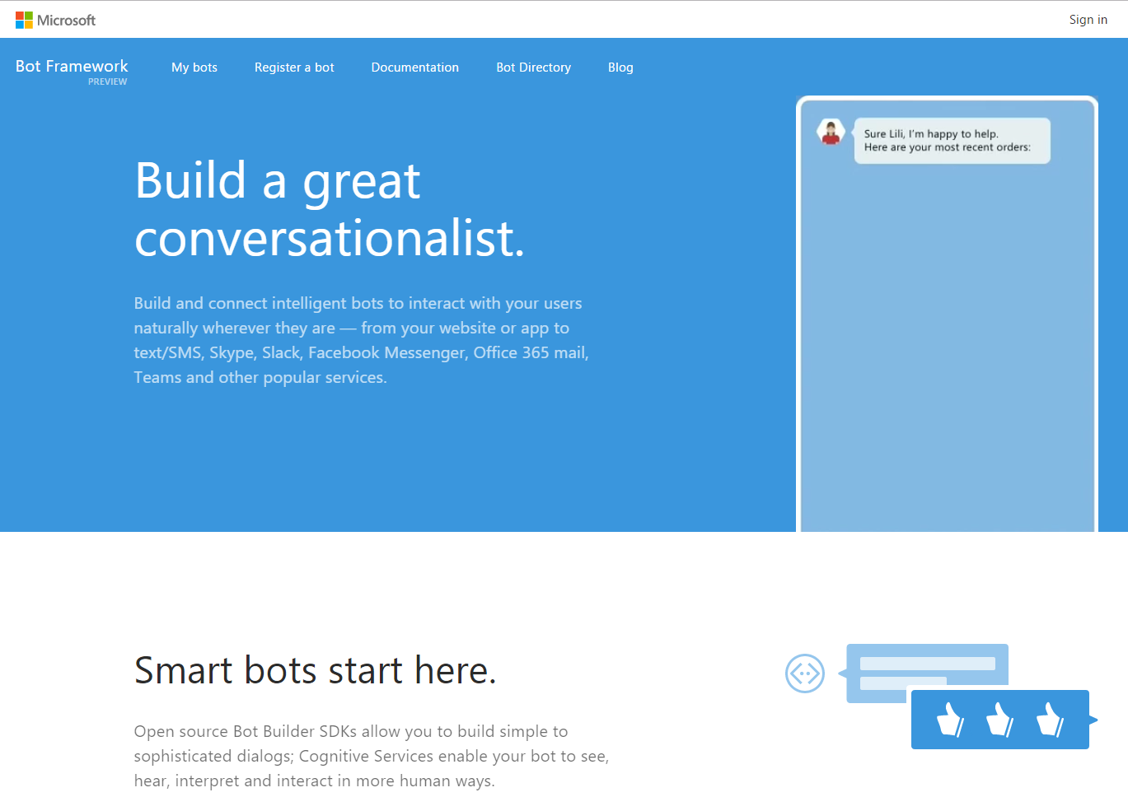






Bot Framework
Bot Developer Portal
Bot Builder Guides
Bot Directory
Notes:
Main page: https://botframework.com

Slide 25
What is the Bot Framework
It’s also a messaging platform
Let’s get a picture of the way it works

Slide 26
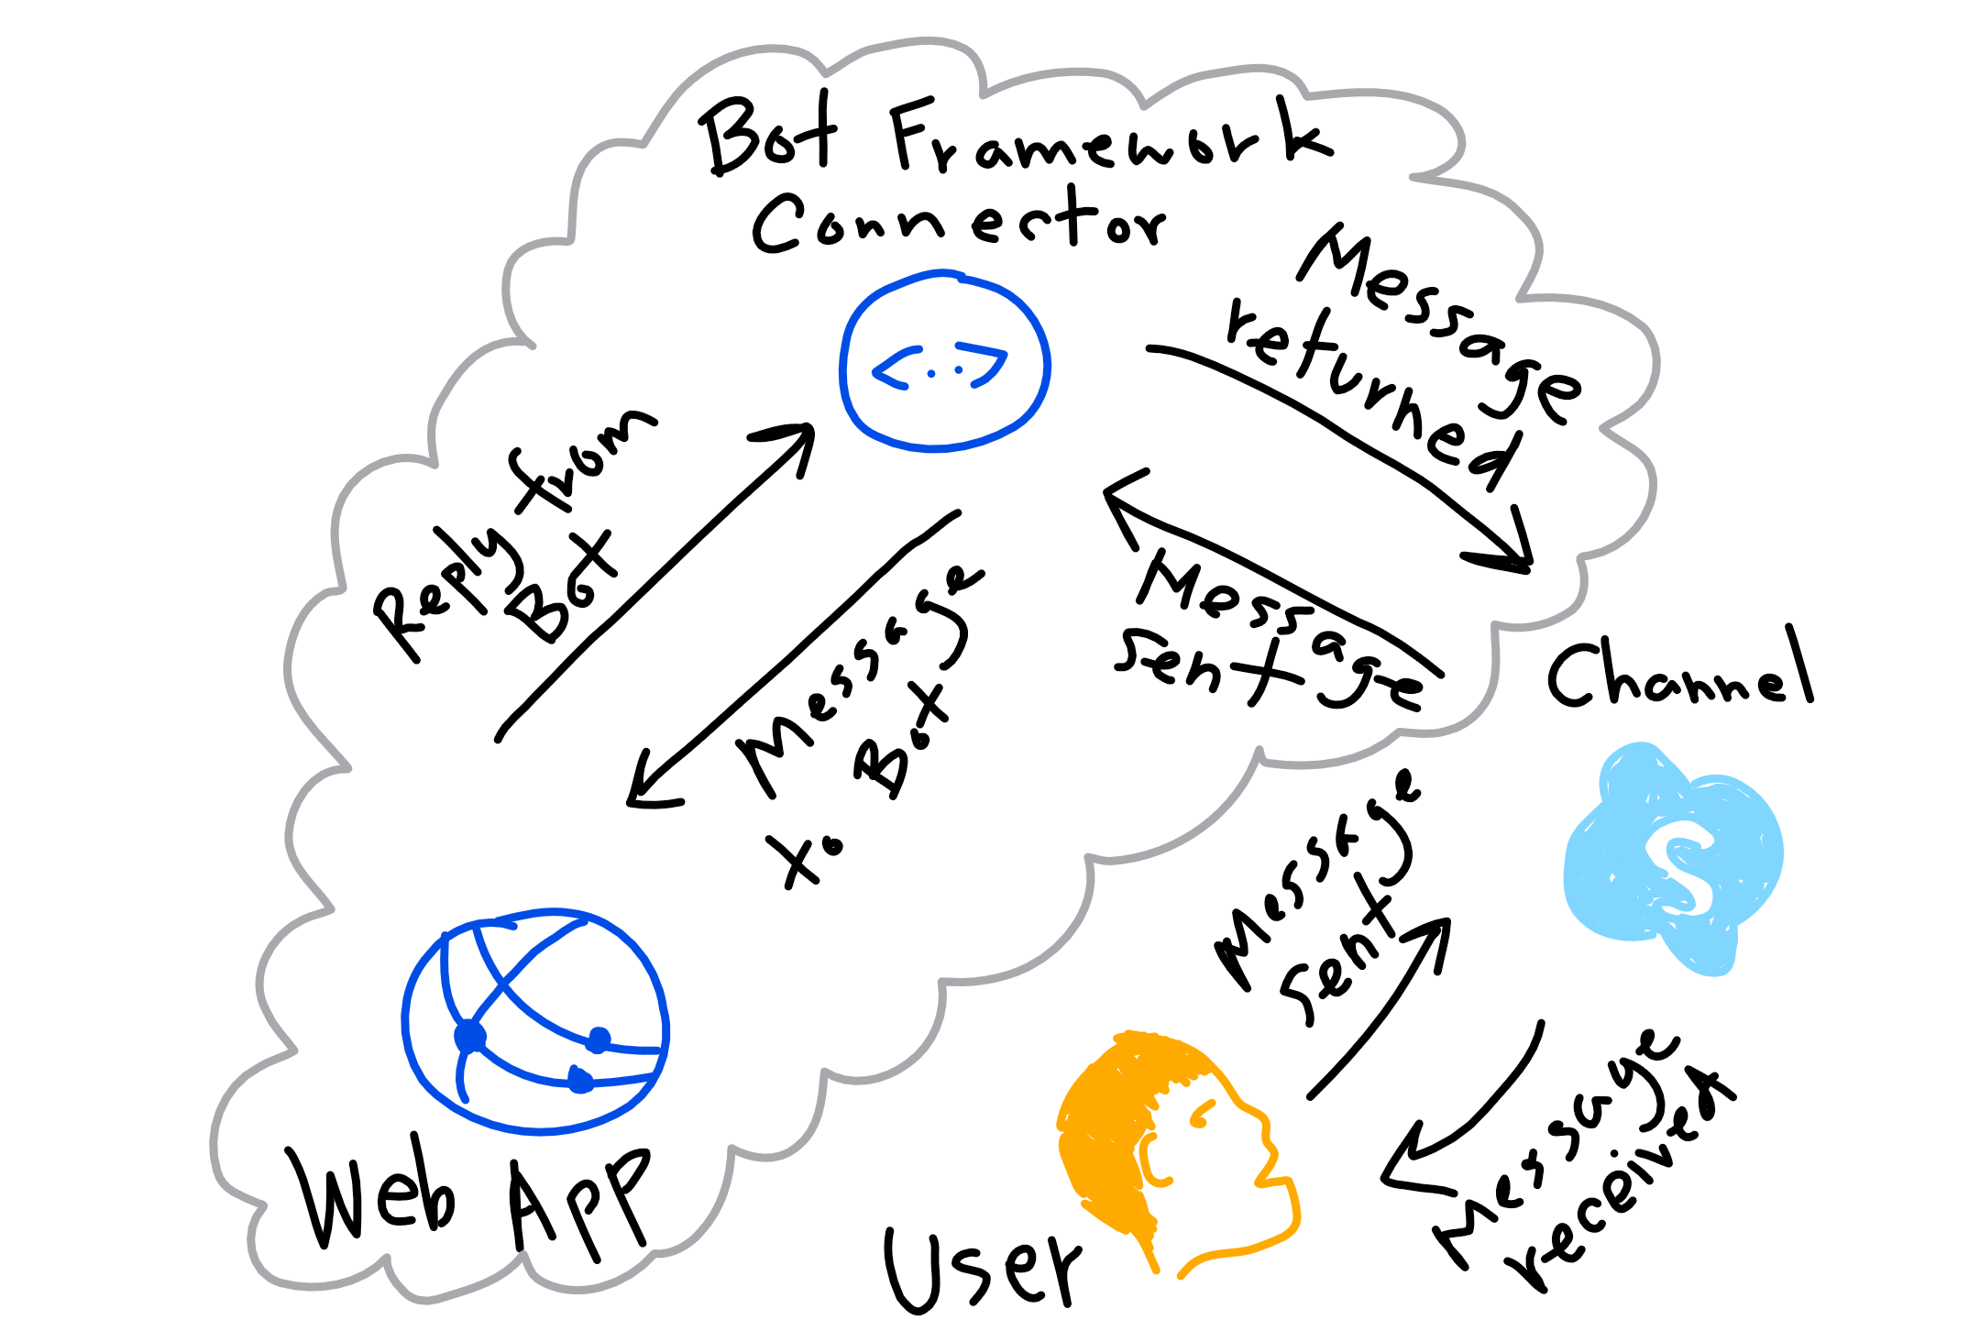
What is the Bot Framework: as a cloud solution

Slide 27
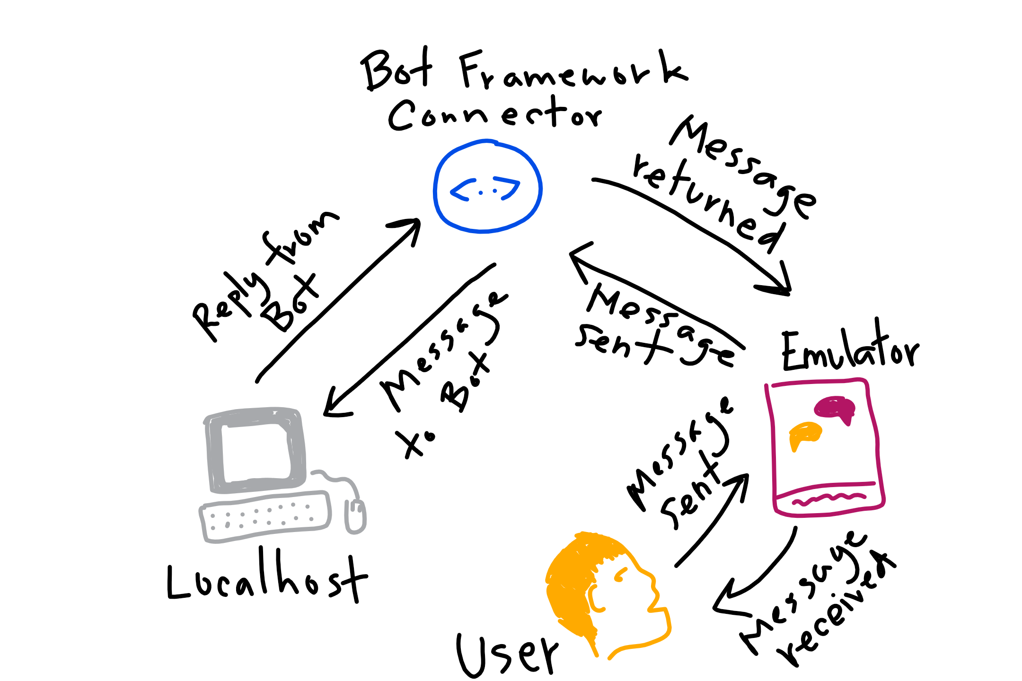
What is the Bot Framework: as a development solution

Slide 28
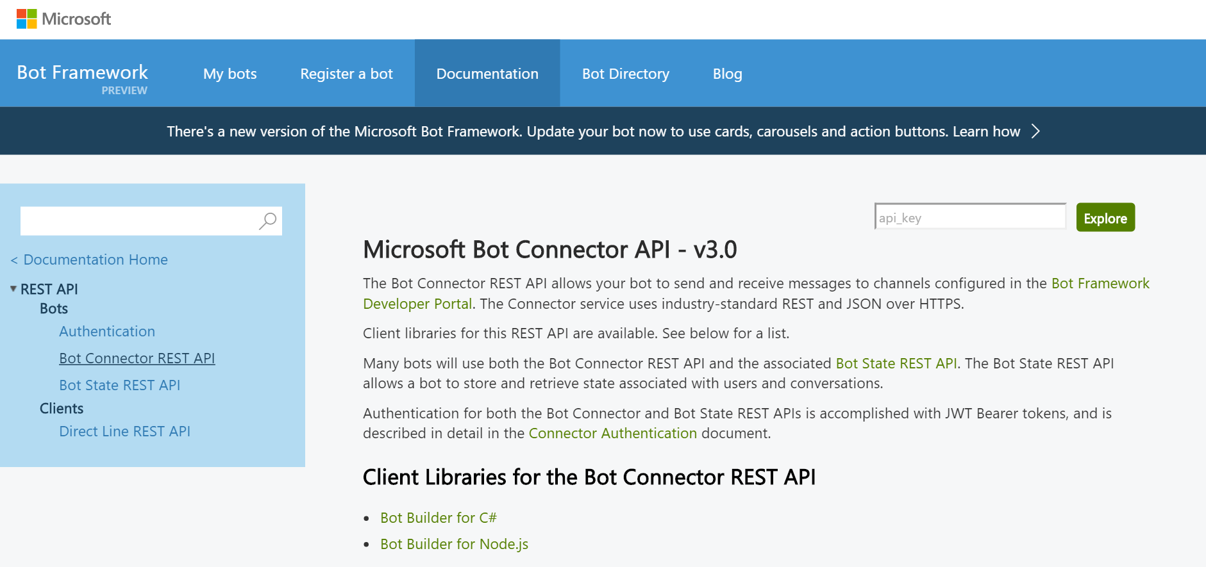
Bot Builder: Development Kits and REST
Bot Builder SDKs for:
.NET framework for C#
Node.js
And there’s also
REST and REST State APIs
Notes:
SDKs infographic: http://docs.botframework.com/en-us/images/faq-overview/bot_builder_sdk_july.png

Slide 29
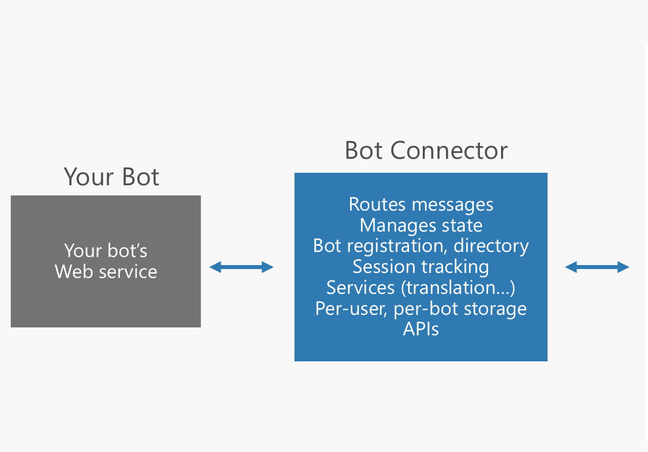
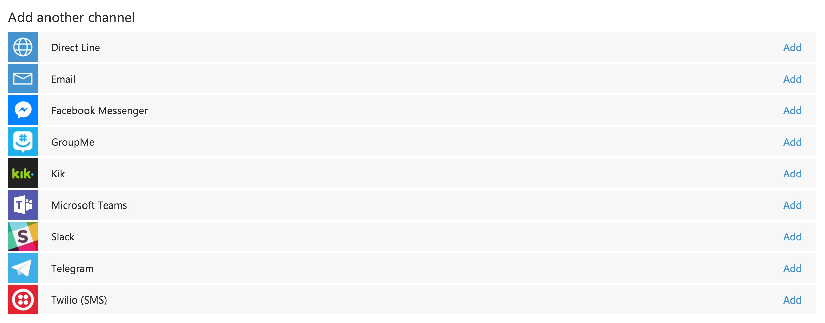
Bot Connector (part of Bot Builder)
Notes:
It’s part of the Bot Builder SDK
http://docs.botframework.com/en-us/csharp/builder/sdkreference/gettingstarted.html#channels

Slide 30
Developer Portal
Bot Developer Portal

Slide 31

Developer Portal: what registration does for you
Your bot’s web service in the cloud
MS Bot Framework Connector
Notes:
Expose a Microsoft Bot Framework-compatible API on the Internet, then the Bot Framework Connector service will forward messages from your Bot to a user, and will send user messages back to your Bot.

Slide 32
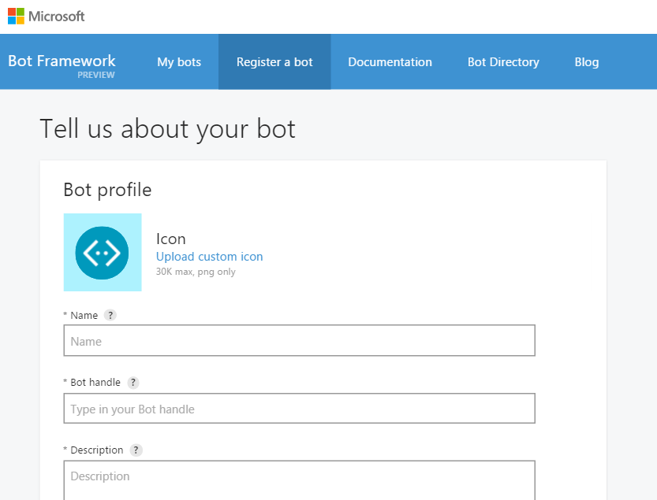
Register a Bot in the Developer’s Portal
Notes:
Register on the developer portal by clicking the ‘Register a bot’ link: https://dev.botframework.com/bots/new
Name: TemplateBot
Bot Handle: templatebot (for referencing in Bot Directory and name for bot on web chat, NOT the app’s URL used as endpoint)
Also, add a description here
Configuration
Remember the URL endpoint from deploying endpoint step. Should be something like: “https://botwebappname.azurewebsites.net/api/messages”
You’ll go through the “Generate App ID and password” wizard, then return to the registration page.
Go back and edit this profile anytime

Slide 33
What about all of the message data?
The Bot Framework manages the conversation, user and dialog data
This data is called State and the manager is the State Service

Slide 34






State Service: types of bot data stored for us
User-conversation data
Conversation data
User data
Dialog data
This data is currently stored for free for you within the Bot Framework State Service.
However, you may bring in your own data source (format: key-value store)
Notes:
User data – globally available for user across all conversations
conversation data – stores globally for a single conversation (many users could be involved)
User-conversation data – stores globally conversation data for a user (But private to just that user)
Dialog data as well – persists for a single dialog (helpful for temp data in a waterfall set of steps)

Slide 35
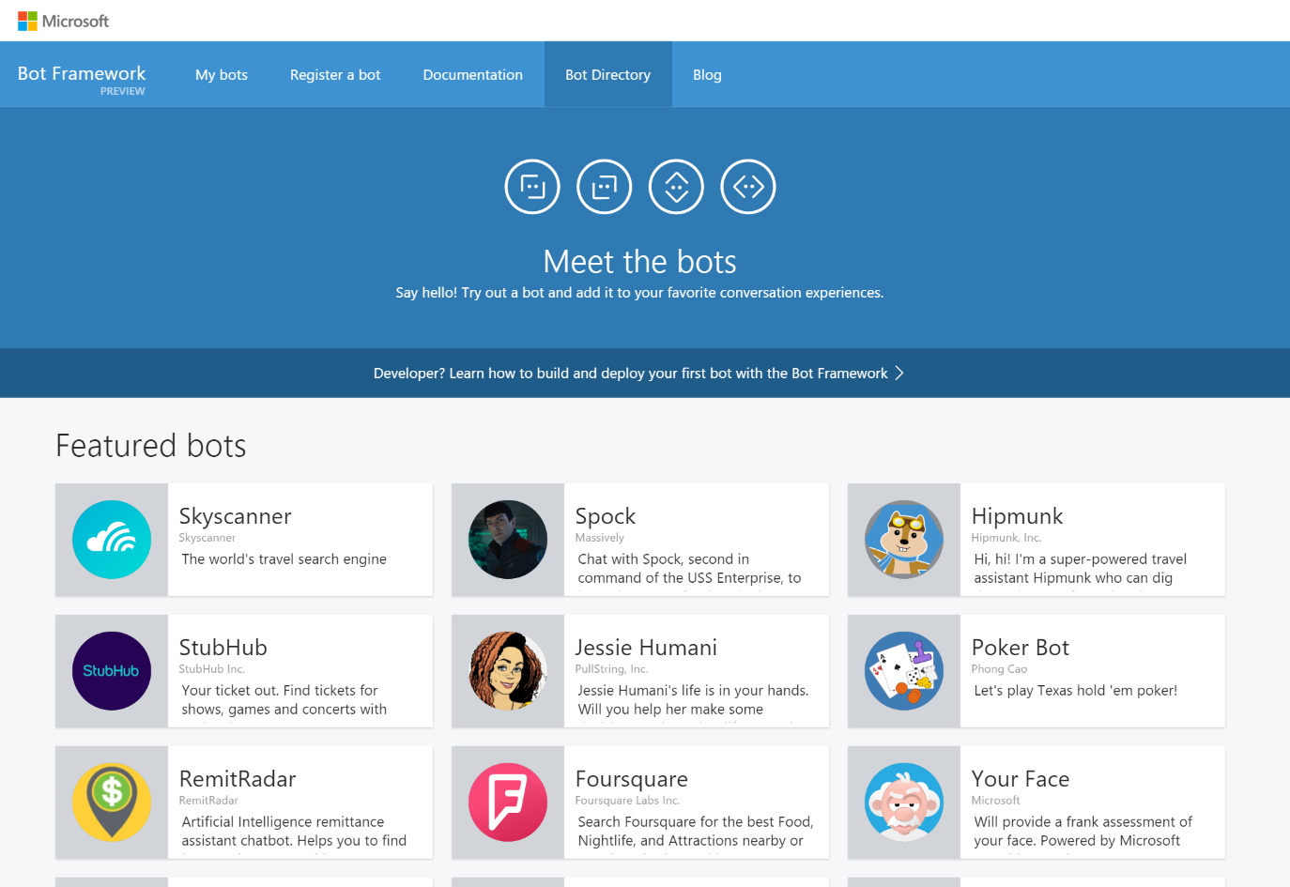
Bot Directory
Public Directory of Bot Framework Bots
Discover, try, and add bots from here with no added configuration
Bots are public at developer discretion; must be reviewed
Searchable here
Notes:
Bots must be submitted for review and approved in order to appear in the directory
As of Nov. 17, 2016 there are 94 bots in the directory from MS and other companies

Slide 36
The Benefits of the Bot Framework
For developers
Bots are more capable nowadays so more functions
Bot Builder SDKs or custom code – you have choices
Faster testing, dev and deployment
Easy integration with the cloud
Growing community
For end users
User choice of channels
Users have trust and control of their data
New experiences
For businesses
Broad access to their customers and new experience
Reduced cost of development
High quality bots
Notes:
For developers
Bots are more capable because of supporting services i.e. MS Cognitive Services and BF State Service
Bring your own bot or build your own bot with the Bot Builder SDKs
With SDKs and sample code on github
Smooth cloud deployment and integration
Big community (open source community, issues, gitters, stackoverflow – active and responsive)
For end users
Users can choose from a variety of conversation channels
Users have trust and control of their data – encrypted and accessible anytime
Frictionless fun or at least makes something much easier
For businesses
Broad access to their customers where they already are conversing giving them new experiences
Reduced cost of development – just faster with SDKs and builtin functionality like dialog handling and language understanding
High quality bots (big support and dev community) as well as, bots are reviewed after publishing and surfaced on Bot Directory

Slide 37
Working with channels

Slide 38
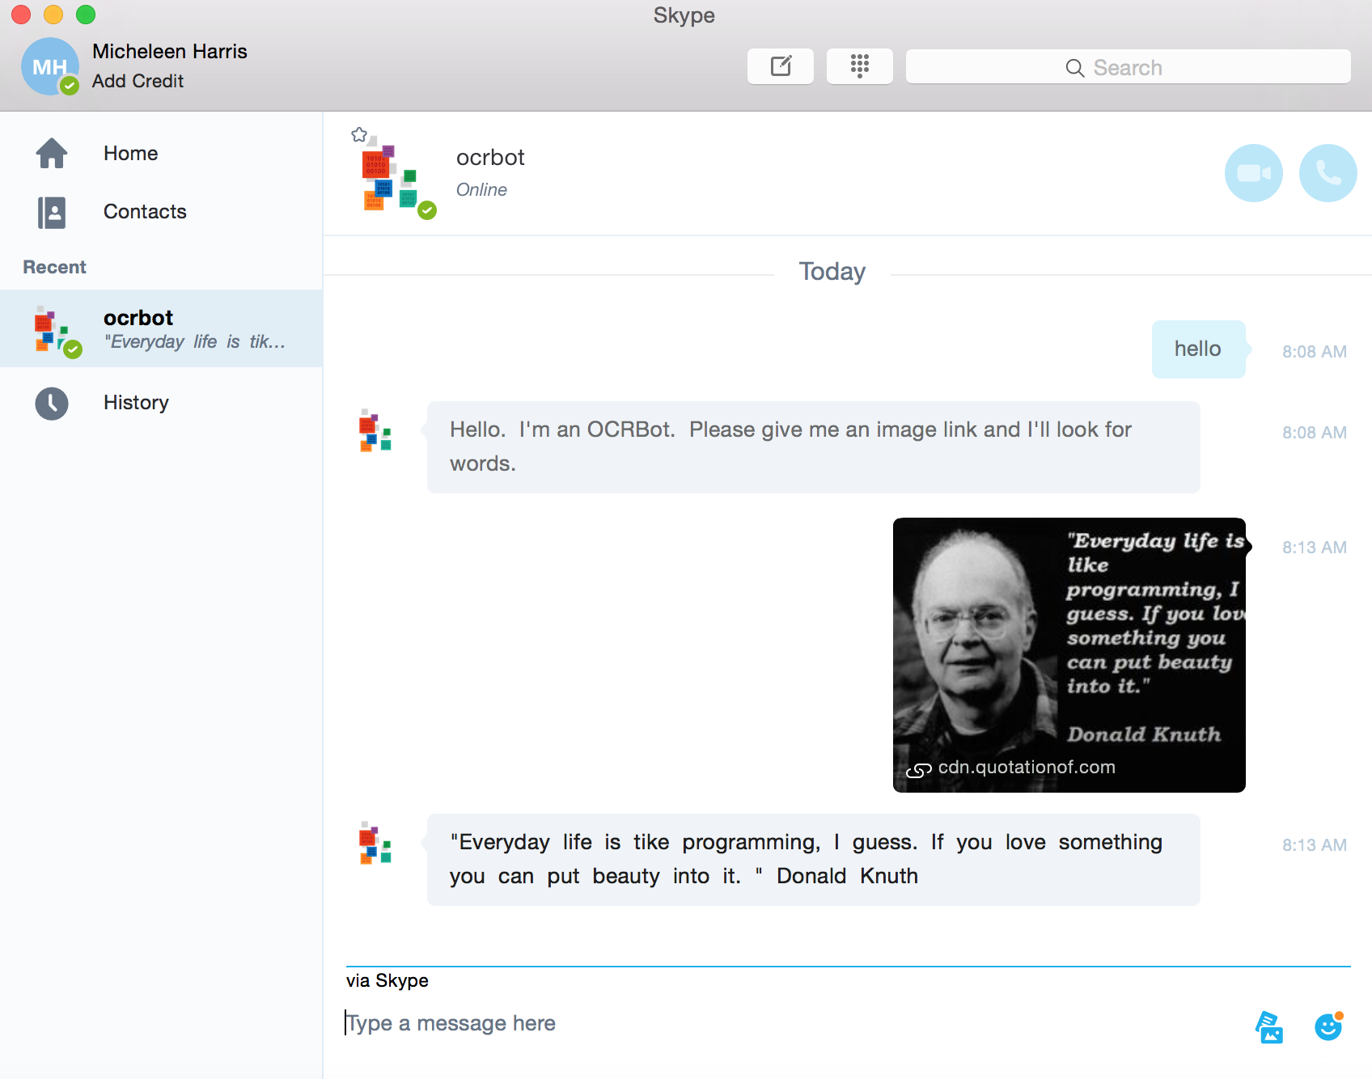
Skype channel example

Slide 39
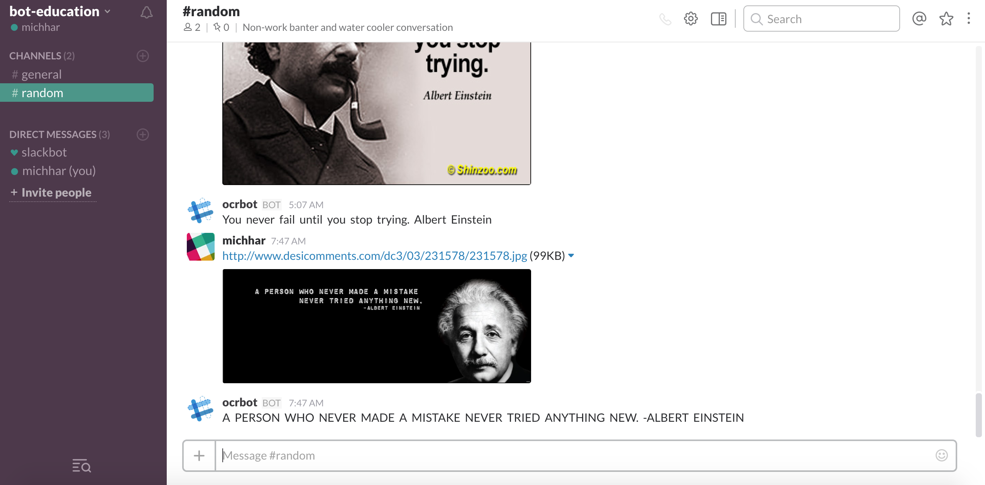
Slack channel example

Slide 40
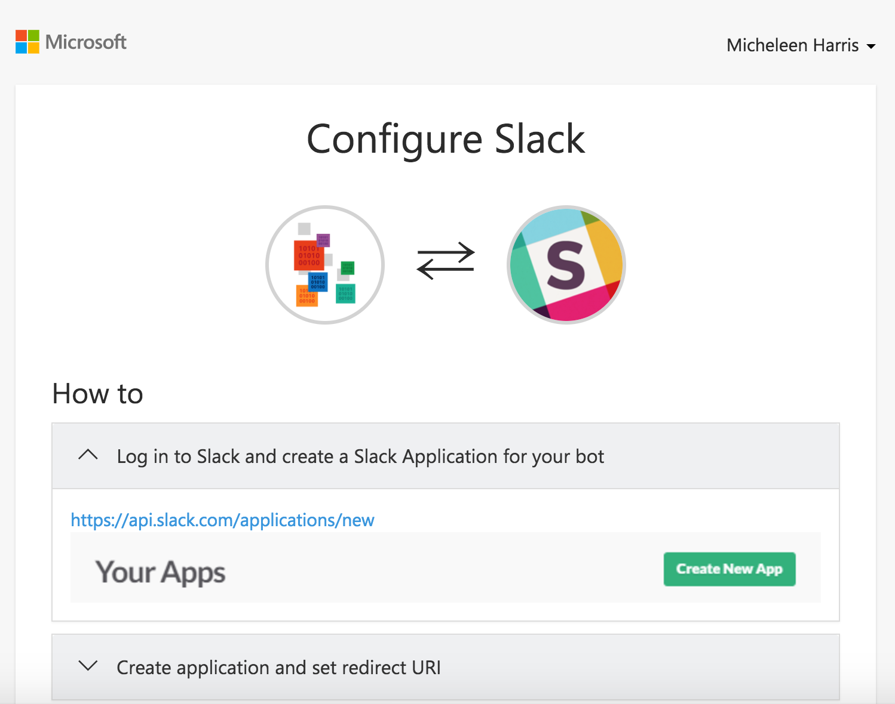
Adding a channel
Skype is added by default
Instructions are laid out
Notes:
Often, the most time will be spent configuring your credentials as a developer on the target service, registering your app, and getting a set of Oauth keys that Microsoft Bot Framework can use on your behalf

Slide 41
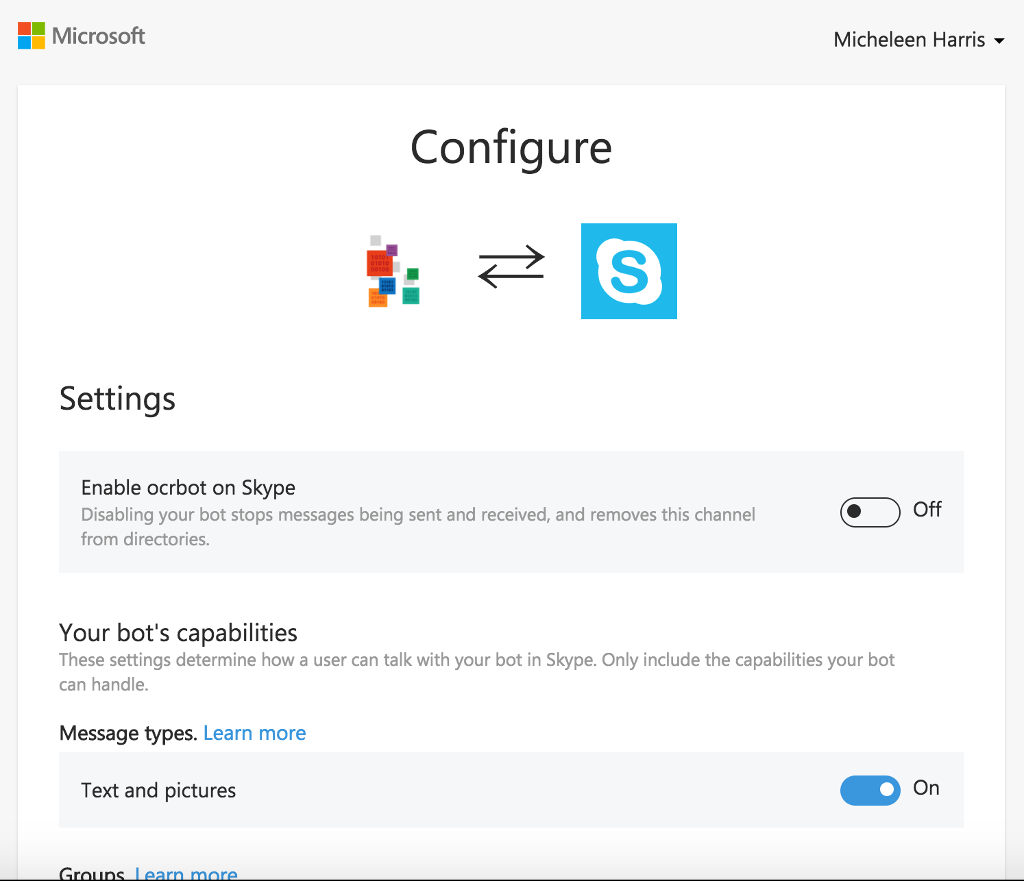
Editing a channel
Skype for instance, through configuring we can:
Disable/enable globally
Turn on/off group messaging
and more

Slide 42
Toolbox
Notes:
Let’s see some tech stuff and code!

Slide 43
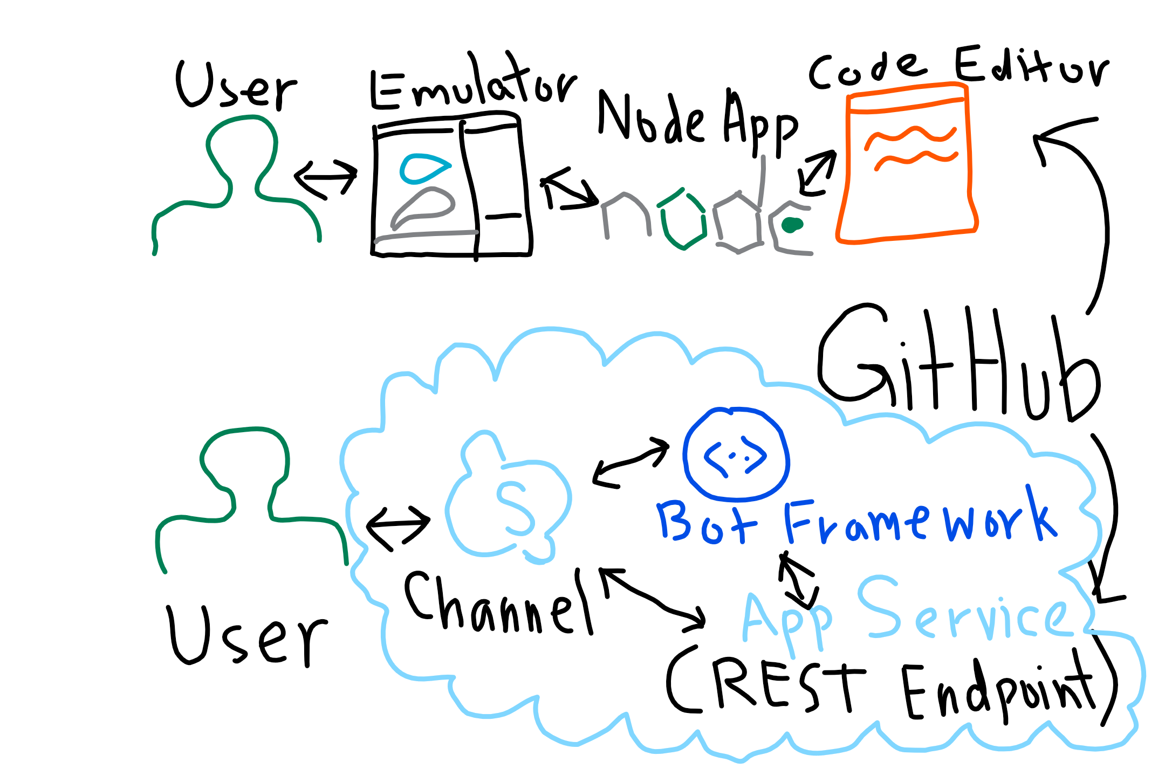
Dev process

Slide 44
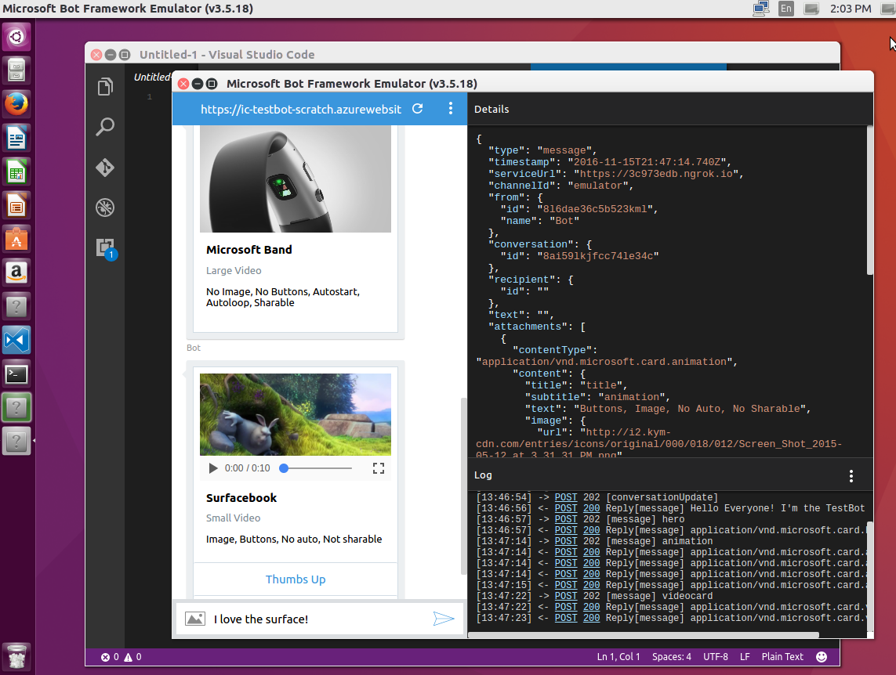
The BF Emulator – New Unix-Compatibility
New Support for Mac, Linux and Windows
New All the Bot Framework card types are supported
New Save multiple profiles for when you’re working online and off
New Simplifies configuration when you’re working with ngrok
New Uses the webchat control for higher fidelity layout and consistency with the webchat experience
Notes:
Emulator purpose:
Send requests and receive responses to/from your bot endpoint on localhost
Inspect the Json response
Emulate a specific user and/or conversation

Slide 45
Node App: Bot Builder Node.js SDK
Get the package as easy as this one line in the terminal:
npm install --save botbuilder
Or to clone the latest entire repository (also where the SDKs are):
git clone https://github.com/Microsoft/BotBuilder.git
cd BotBuilder/Node
npm install
Notes:
We will set up after the Cognitive Services Overview
https://docs.botframework.com/en-us/node/builder/guides/core-concepts

Slide 46
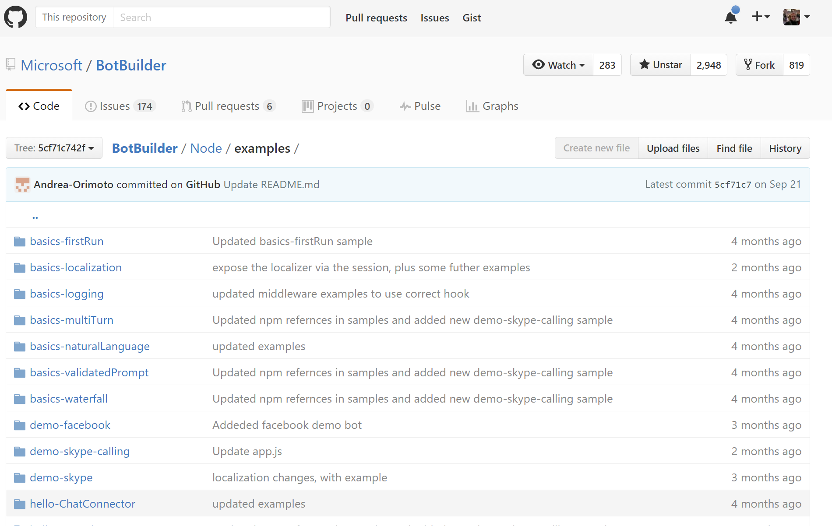
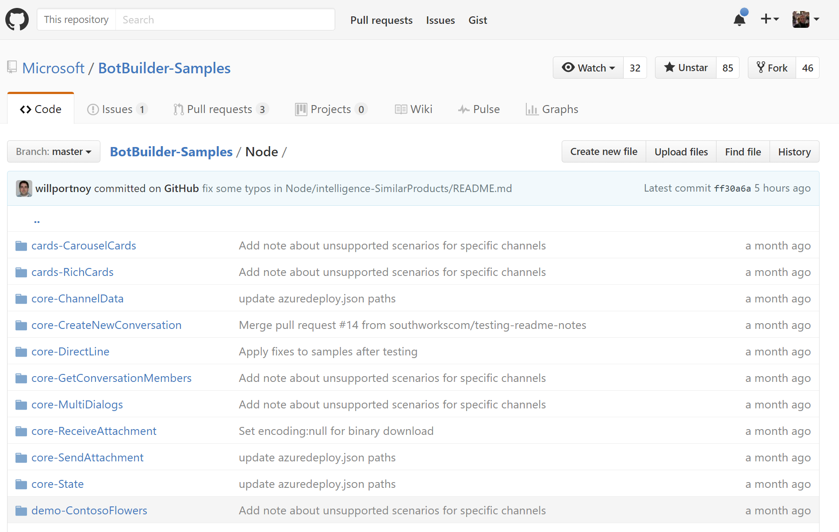
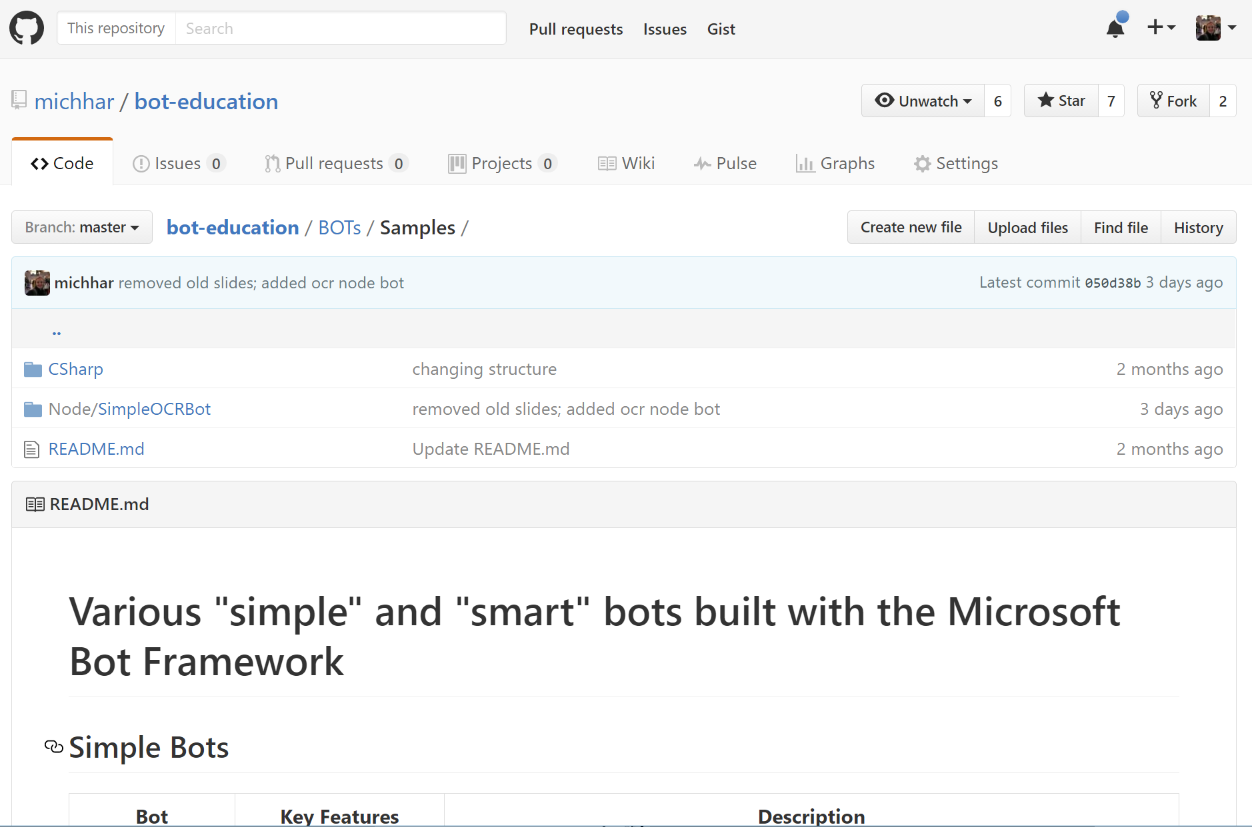
Tons of sample code on GitHub
On github from Microsoft (and elsewhere):
Notes:
Go to repository link and in Git Bash type: git clone <http cloning link from page>
https://github.com/Microsoft/BotBuilder-Samples
https://github.com/Microsoft/BotBuilder/tree/master/CSharp/Samples
https://github.com/Microsoft/BotBuilder/tree/master/Node/examples
https://github.com/Azure/bot-education/tree/master/Student-Resources/BOTs
https://github.com/MicrosoftDX/botFramework-proactiveMessages
And many more to be found
More out there…so many, can’t list…

Slide 47
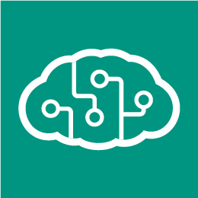
Integration with cognitive services

Slide 48


Cognitive Services meet Bots
Cognitive Skills
Learn
See
Converse
Hear
Discover
Reason
We’ll learn how to add
Cognitive Skills to your Bots
Build smarter experiences that delight and engage your users
GOAL

Slide 49

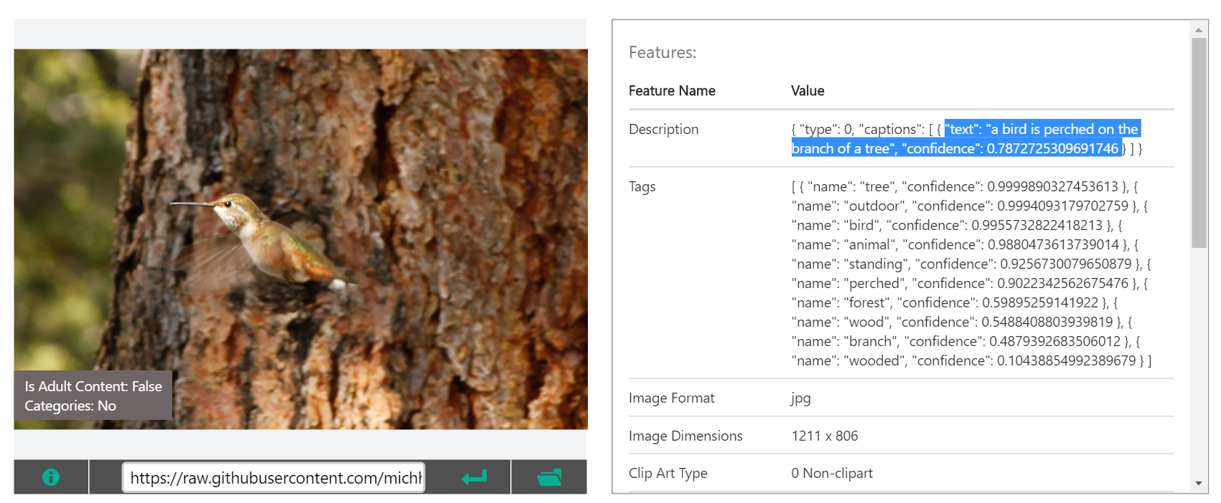
Cognitive services vs. bots
We can have a bot without cognitive services.
We can have an intelligent app without a bot.
Notes:
Stubhub: Find tickets for shows, games and concerts with StubHub.
Computer vision API demo on this page: https://www.microsoft.com/cognitive-services/en-us/computer-vision-api

Slide 50
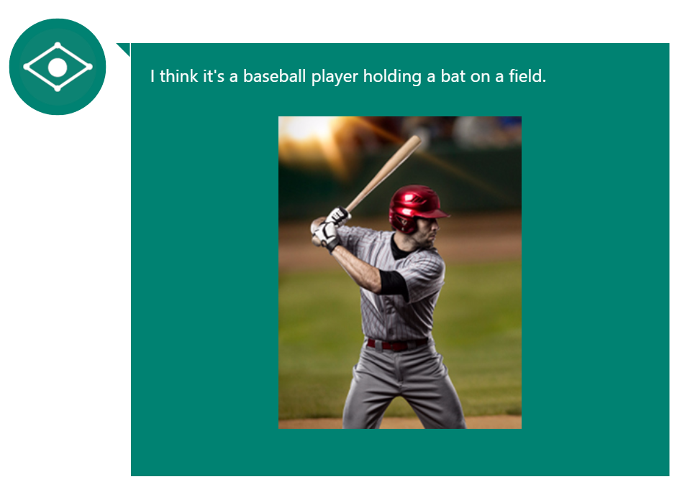
A few use cases
Create human readable captions for the content of an image
Authenticate users using a voiceprint
Recognize the intent of a user
Recommend products frequently bought together
Ease the burden of typing queries in a conversational setting with autosuggest
Captionbot.ai
Notes:
Computer Vision API - Like CaptionBot.ai – a bot that reports back in human way the contents of an image
Speech API - Authentication as a user speaks to the bot with a speaker verification profile or “voiceprint”
LUIS API for analysis of queries such as “What is the weather in Toyko today?” using entities to parse out intent (what the user is asking for)
Knowledge API. Recommendations based on our knowledge and/or a user’s history. Also, could search through a graph or user-defined database to return relevant academic papers from a natural language query
Bing Search API for autosuggest - Search also has other capabilities such as returning the latest trending news on a topic for example

Slide 51
More complex examples
Ensuring proper advice and experience for customers of wealth and investment management
Monitoring potential changes to relevant laws and alerting lawyers when changes occur
Presenting the right products to customers at the most appropriate point in the buying cycle
Providing trip-planning advice that travelers find relevant
Notes:
Would you build a bot or not for these?
Credit: Post by Manoj Saxena at https://www.fastcodesign.com/3068005/whats-still-missing-from-the-ai-revolution

Slide 52

Bot Framework
Add Bot intelligence
Get the info in the Bot Framework docs
Notes:
Landing page for the bot framework: https://botframework.com
Excellent Documentation: https://docs.botframework.com

Slide 53
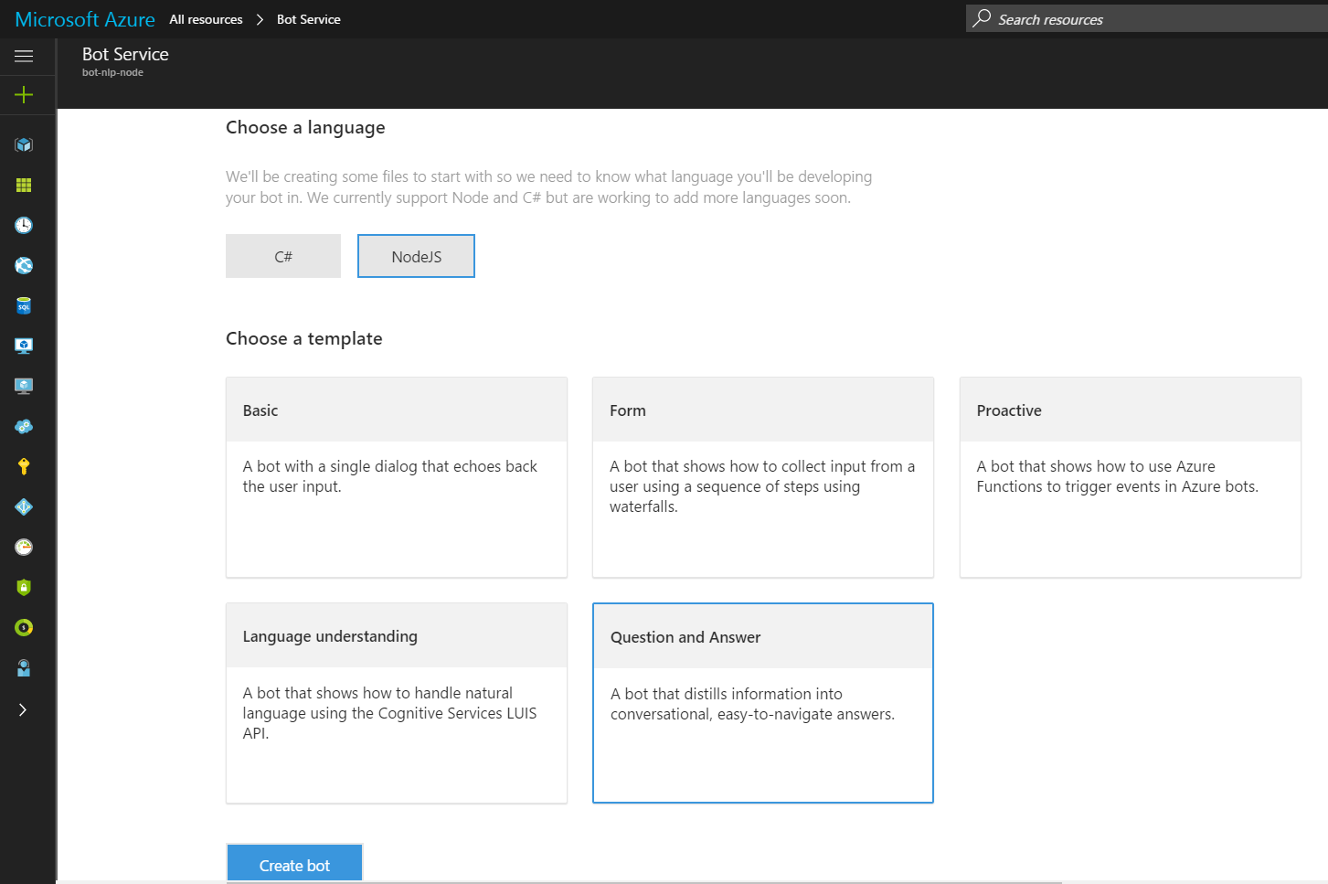
Azure Bot Service Bot Framework
From Azure Bot Service:
Fire up LUIS bot
Fire up QnA bot
more templates…
Notes:
Some instructions for creating your first bot with Azure Bot Service: https://docs.botframework.com/en-us/azure-bots/build/first-bot/#navtitle
This is very easy, but has many limitations.
However, you can download the code for this Bot and create a more advanced solution (recommended)
Done through the Azure Portal
Options as of now for templates are:
Basic
Form
Proactive
Language understanding
QnA

Slide 54
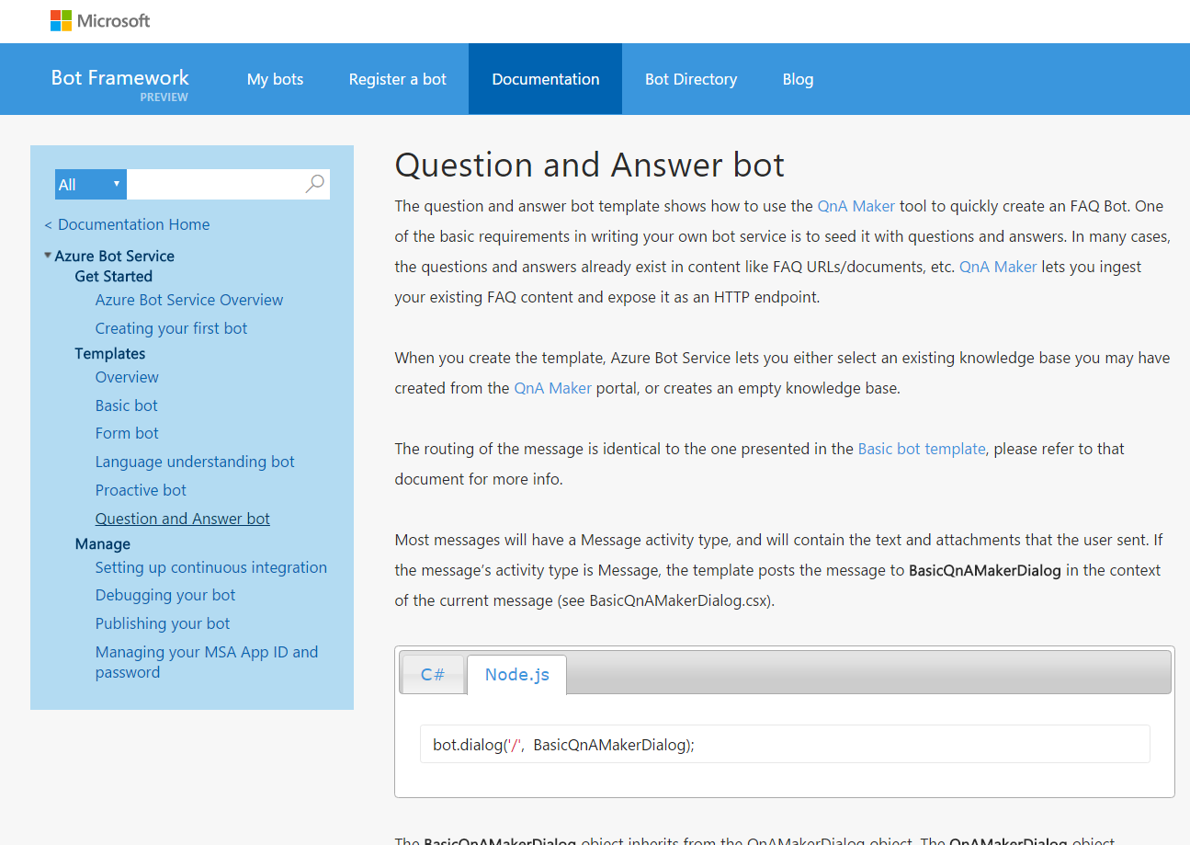
QnA Bot Bot Framework QnA Maker
Notes:
A QnA bot guide (can choose the SDK here): https://docs.botframework.com/en-us/azure-bot-service/templates/qnamaker/#navtitle

Slide 55




















More integrations…
LUIS is tightly coupled in the SDKs
Easy to integrate any Cognitive Service with it’s REST API
Notes:
Caveat – some chaining of cognitive services may have to be done, however ones like LUIS and QnA maker are easy to integrate as they have similar mechanisms

Slide 56

Parting thought (before the lab)
We can aim for our bots to: Be transparent and have algorithmic accountability so that humans can undo unintended harm. (Satya Nadella)
Notes:
Ethical and societal considerations taken directly from an article by Satya Nadella: https://www.linkedin.com/pulse/partnership-future-how-humans-ai-can-work-together-solve-nadella

Slide 57
Resources
Support | Contact
Technical FAQ | https://docs.botframework.com/en-us/technical-faq
Bot Builder SDK issues and suggestions | Use the issues tab on our github repo: https://github.com/Microsoft/BotBuilder/
Using a bot | Contact the bot’s developer through their publisher e-mail
Community support | Use StackOverflow, with the hashtag #botframework
Reporting Abuse | Contact us at bf-reports@microsoft.com
Gitter discussion forum | https://gitter.im/Microsoft/BotBuilder
Notes:
https://docs.botframework.com/en-us/support

Slide 58
Prerequisites for the lab parts
GitHub account
Microsoft account
VSCode
Node.js with npm installed locally
Git bash
Bot Framework emulator
Azure account[recommended and needed to deploy]

Slide 59
Lab Bot dev environment
Notes:
Instructions (lab links also in the wiki under the Agenda for the Syllabus)
https://github.com/Azure/bot-education/blob/master/Student-Resources/Labs/Node/Lab1_SetupCheck.md

Slide 60
Questions?
Also, try the course gitter chatroom at aka.ms/botedu-discuss

Slide 61
Bot Framework Developer Introduction and Deploying an Intelligent Bot

Slide 62
Getting started
Notes:
Core concepts: https://docs.botframework.com/en-us/node/builder/guides/core-concepts/#navtitle

Slide 63
Dev process/Toolbox

Slide 64
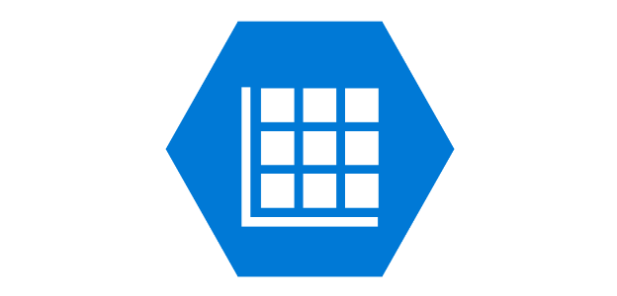



Components of deploying your bot
Web service
Bot Framework service
Data store service
Local project
User
Channel
Notes:
Steps:
The developer writes their bot code, leveraging the BF libraries in the SDKs and APIs available
Create an endpoint for the bot to talk to in the cloud
Connect to the Bot Framework service (Connector and State services)
Pass user and conversation data between channel and Framework (data store in the state service, managed by the BF)
The user interacts with the bot on a channel of their choosing

Slide 65
Session outline (and steps to releasing a bot)
Develop
Deploy
Register
Publish
Test
Deploy a bot to Azure lab

Slide 66
Develop in code editor

Slide 67
Bot Framework concepts

Slide 68
Connector
A service that connects bot to multiple channels (skype etc…)
The UniversalBot class manages all conversations between bot and users
The ChatConnector class
Connects the bot to the connector service
“Normalizes” the message e.g. converts from webchat to SMS

Slide 69
Messages
Messages can consist of:
Text to be displayed
Text to be spoken
Attachments
Cards
Suggested actions
The session.send method sends messages to user

Slide 70
Dialogs
The building blocks of a conversation flow
A conversation is a stack of dialogs
The most recent one is on top of the stack

Slide 71
Actions
Action | Description
triggerAction | Binds an action to a dialog, makes it active when triggered.
cancelAction | Binds an action to a dialog and cancels it when it triggered.
reloadAction | Binds an action to a dialog and reloads it when triggered (e.g. in response to “start over”)
beginDialogAction | Binds an action to the dialog that starts another dialog when triggered.
endConversationAction | Binds an action to a dialog that ends the conversation with the user when triggered.
Manage interruptions
Triggered by global message handlers

Slide 72
Recognizer
Recognize user intents based on input and trigger appropriate actions
Built-in regular expression recognizer
bot.recognizer(new builder.RegExpRecognizer( "CancelIntent", { en_us: /^(cancel|nevermind)/i, `
ja_jp: /^(キャンセル)/ }));
External services such as LUIS (natural language understanding)
Custom recognizers
Custom functions to be associated with an action via a “matches” trigger
var model = <endpoint of LUIS model app.>
bot.recognizer(new builder.LuisRecognizer(model));

Slide 73
State
Bots as wep apps are stateless
Bot Service provides a storage system
Use properties of bot.session object to store data:
userData stores user information across all conversations
conversationData stores information for 1 conversation
It is visible to everyone
It is disabled by default. Set persistConversationData
privateConversationData stores 1 conversation data for current user
dialogData stores information for 1 dialog. Useful for waterfall steps.

Slide 74
Concept and code: create the bot
UniversalBot – a simplified way to connect bots to dialogs
// Create bot
var bot = new builder.UniversalBot(connector);
// Dialog handling
bot.dialog('/', function (session) {
session.send('Hello World');
});
Notes:
You will use your setup environment in VSCode (or elsewhere) to work through these examples. The code is also at: https://github.com/Azure/bot-education/blob/master/Student-Resources/BOTs/Node/bot-playground/server.js
Note on dialogs: Bot Builder breaks conversational applications up into components called dialogs. If you think about building a conversational application in the way you’d think about building a web application, each dialog can be thought of as route within the conversational application.
From: https://docs.botframework.com/en-us/node/builder/guides/core-concepts
UniversalBot ( https://docs.botframework.com/en-us/node/builder/chat-reference/classes/_botbuilder_d_.universalbot )
has a lightweight connector model and includes ChatConnector and ConsoleConnector classes
your bot can even utilize both the ChatConnector and ConsoleConnector and others at the same time if so desired
replaces and unifies old classes like BotConnectorBot and TextBot
updates and changes from https://docs.botframework.com/en-us/node/builder/whats-new/

Slide 75
Concept and code: create bot with handler
New code style in botbuilder release v3.5.0: create the bot with the root message handler at the start
var bot = new builder.UniversalBot(connector, [
function (session) {
// Introducing a builtin prompt – first waterfall step
builder.Prompts.text(session, 'Hi! What is your name?');
},
function (session, results) {
// Step 2 in the waterfall
session.send('Hello %s!', results.response);
}
]);
Notes:
You will use your setup environment in VSCode (or elsewhere) to work through these examples.
Really a style choice
This is a more complex sample than just a Hello World bot in the previous slide and has steps – what are the collection of these steps called?
Here we are working with user data and message data

Slide 76


Concept and code: dialog stack
var bot = new builder.UniversalBot(connector);
bot.dialog('/', [
function (session) {
session.beginDialog('/askName');
},
function (session, results) {
session.send('Hello %s!', results.response);
}
]);
bot.dialog('/askName', [
function (session) {
builder.Prompts.text(session, 'Hi! What is your name?');
},
function (session, results) {
session.endDialogWithResult(results);
}
]);
Notes:
You will use your setup environment in VSCode (or elsewhere) to work through these examples.
Here let’s assume we’ve created out bot as in the previous slide (var bot = …)
beginDialog – pushes data onto the “stack”
endDialogWithResults – pops data off of the “stack” and in this case returns the results (we could have done some more interesting things with the data of course…)
Note: both dialog “routes” have small waterfalls

Slide 77
The BF Emulator – Test your code locally
New Support for Mac, Linux and Windows
New All the Bot Framework card types are supported
New Save multiple profiles for when you’re working online and off
New Simplifies configuration when you’re working with ngrok
New Uses the webchat control for higher fidelity layout and consistency with the webchat experience
Notes:
Emulator purpose:
Send requests and receive responses to/from your bot endpoint on localhost
Inspect the Json response
Emulate a specific user and/or conversation
More info on the open source Emulator project page: https://github.com/microsoft/botframework-emulator/wiki/Getting-Started

Slide 78
Deploy to Azure
Notes:
We will do this lab at the end

Slide 79
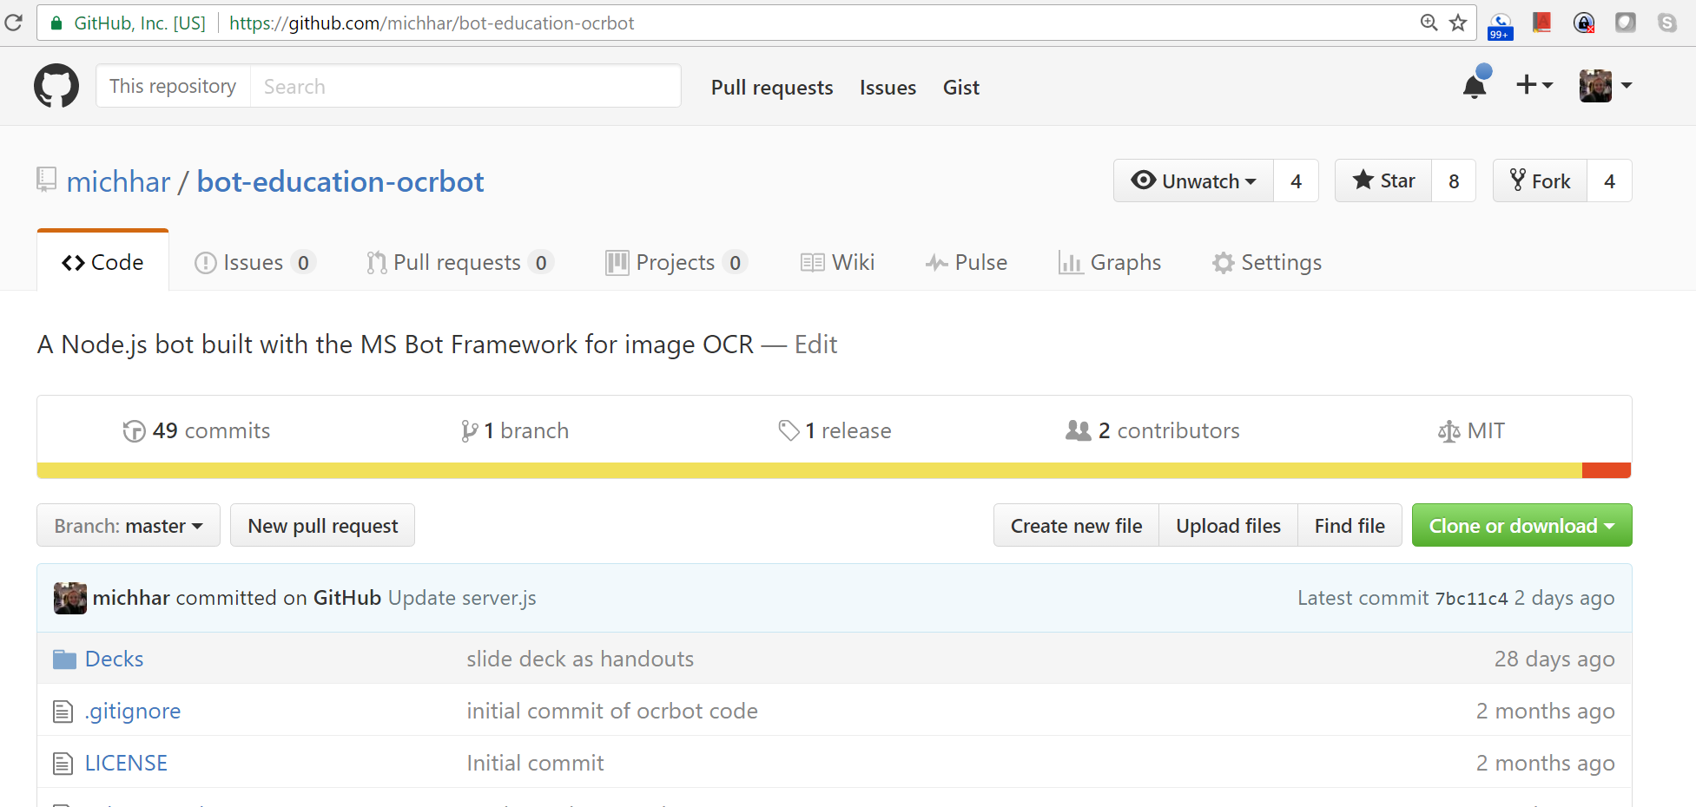
Step 1: Github repo
Your bot code and related files will be on one github repo
Notes:
For example you could fork or clone https://github.com/michhar/bot-education-ocrbot
The server.js is the app
The package.json has the specs on what packages to install
On the command line you’d type:
npm install
node server.js
Note: there are other deployment methods other than from GitHub

Slide 80
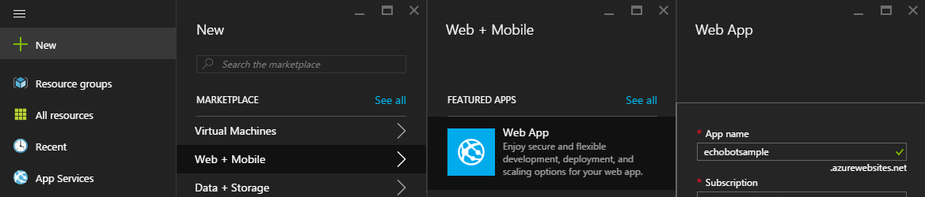
Step 2: Create an Azure Web App
Notes:
In azure portal: https://portal.azure.com

Slide 81
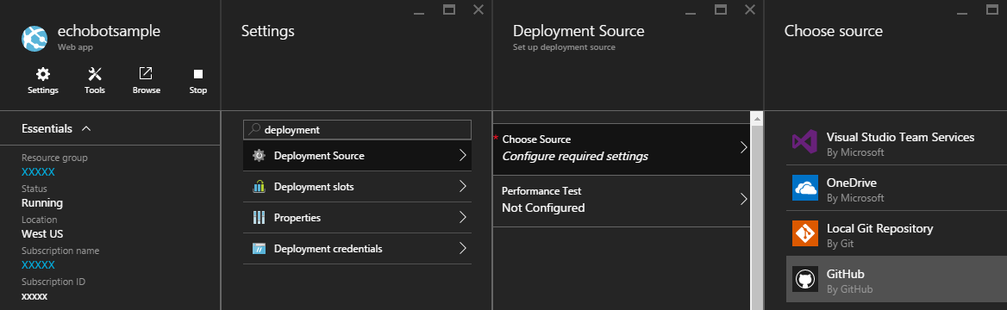
Step 3: Set up for continuous deployment
Notes:
In azure portal: https://portal.azure.com
Select github and enter your credentials for GitHub when asked.
Click on Browse to test the deployment. Should see the message from the index.html file.

Slide 82
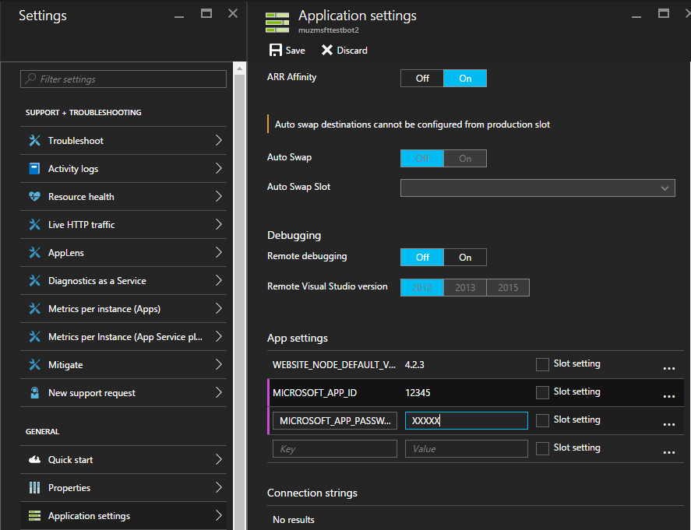
Step 4: Enter in App Id and App Password
Notes:
This allows the password to be safe and guarded.

Slide 83
Register in the Developer Portal

Slide 84
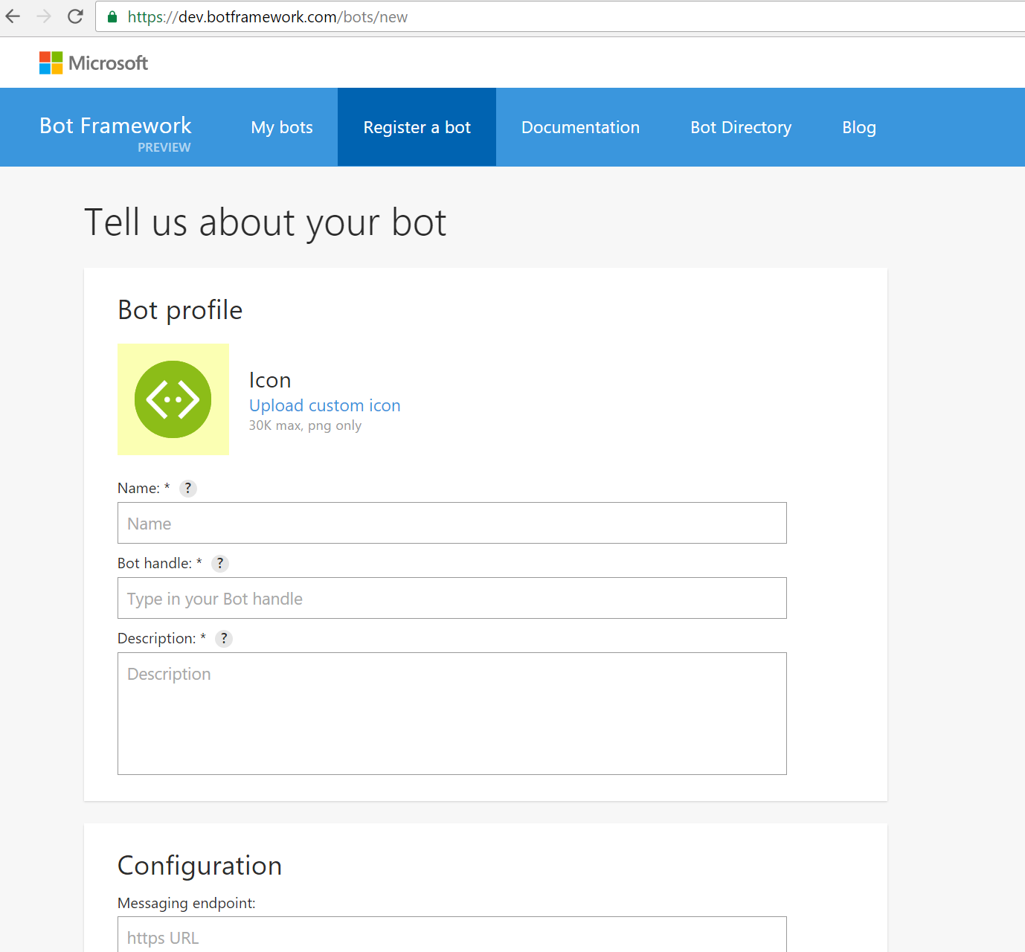
Register in the Bot Framework Developer Portal
Notes:
On https://dev.botframework.com click on “Register a bot”

Slide 85
Publish to the Bot Directory In the Developer Portal

Slide 86
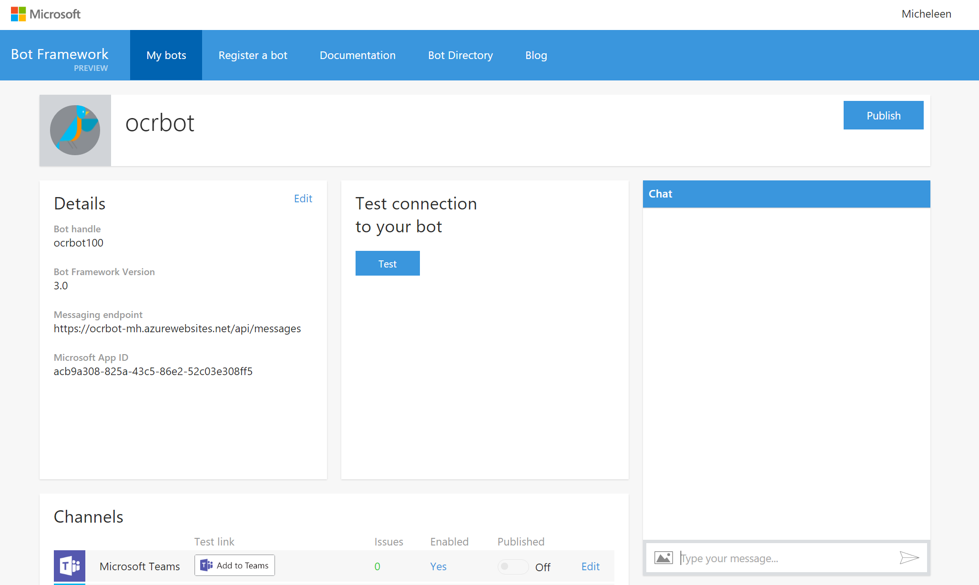

Publish the registered bot
Notes:
If you wish – it will then be reviewed and surface in the Bot Directory
Review guidelines: https://docs.botframework.com/en-us/directory/review-guidelines/

Slide 87
Test connection and conversation

Slide 88
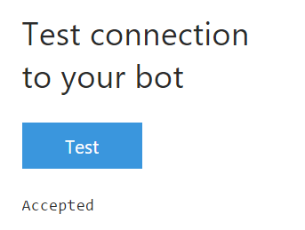
Test the connection to your bot
Simply test connection from the bot developer portal by going to “My bots” in top menu bar
Also, test with the Chat window and/or add to channels

Slide 89
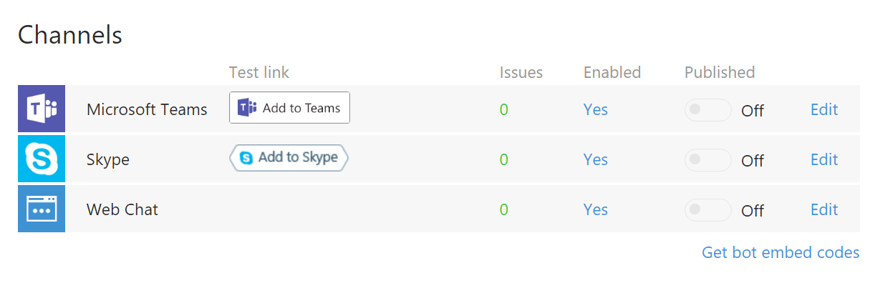
Test connection with channels
Test bot with a pre-configured channels

Slide 90
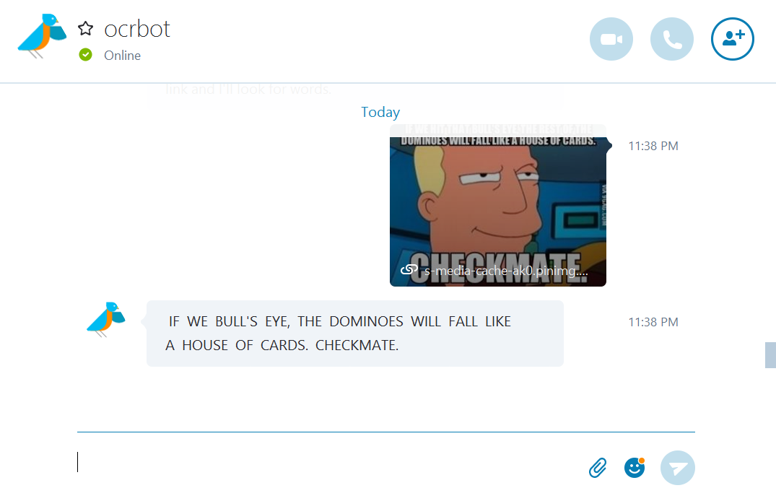
Test connection with a channel
Add bot to contacts in Skype and began a chat…
Notes:
From developer portal page, clicked on test link “Add to Skype” and added bot to my contacts for testing.

Slide 91
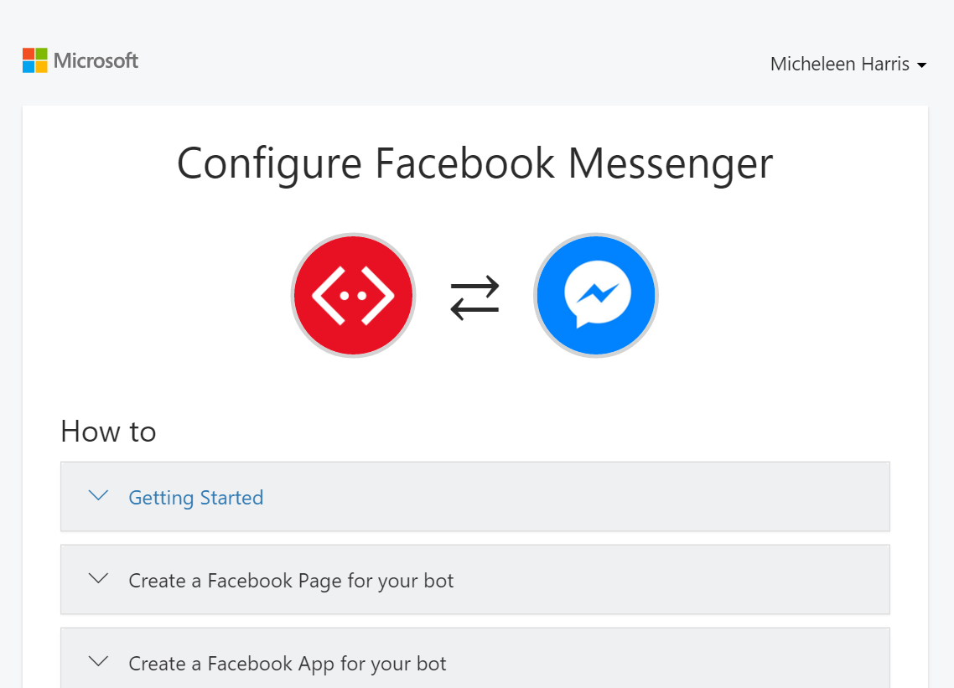
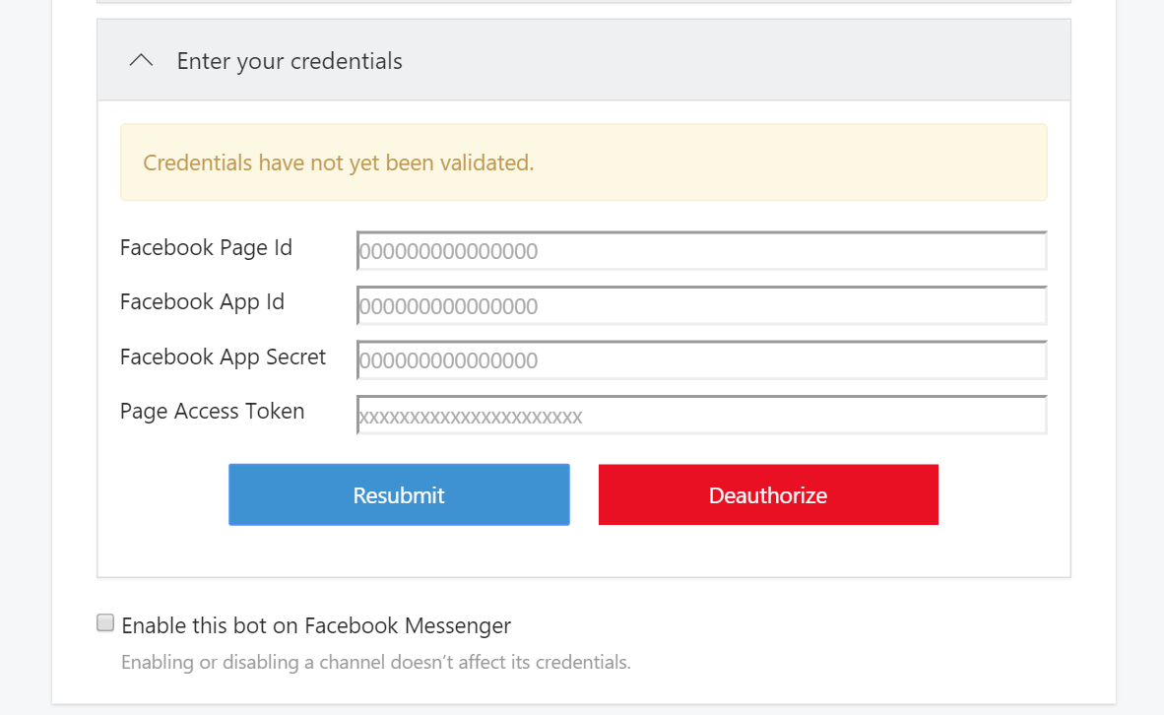
Adding a channel
Many channels will require your credentials as a developer on the service, e.g., Facebook channel
Notes:
Often, the most time will be spent configuring your credentials as a developer on the target service, registering your app, and getting a set of Oauth keys that Microsoft Bot Framework can use on your behalf

Slide 92
Next steps
Publish to Bot Directory
Add bot diagnostics and telemetry with Azure App Insights
Sign up as a developer for other channels supported by the Bot Framework and begin chatting on those as well
Create more bots!

Slide 93
Questions?
Also, try the course gitter chatroom at aka.ms/botedu-discuss

Slide 94
Deploy a bot to Azure
The echobot for Skype and Teams
Notes:
Follow along with the instructor and this guide: https://docs.botframework.com/en-us/node/builder/guides/deploying-to-azure/#i-want-to-setup-continuous-integration-from-github (you may want to “clone” instead of “fork” the repository for echobot)
Also, a useful post on this is at: https://michhar.github.io/posts/ocrbot-makes-a-connection

Slide 95
Deep Dive into the Microsoft Bot Framework
Notes:
If the links in this deck are broken please let us know (mailto: michhar@Microsoft.com). Thanks in advance and enjoy learning about bots and the Microsoft Bot Framework.

Slide 96
Session outline
Basics
QnA bot lab
Conversations and their features
Conversation model
Dialog lab
Attachments lab
State storage
Nonlinear waterfall lab
Intents lab part 1
Adding intelligence
Intents lab part 2
aka.ms/botedu aka.ms/bot-discuss

Slide 97
Basics Code snippets
Notes:
my notes:
You’ve seen some code so far, so let’s dive in to the .NET Bot Builder again.

Slide 98



Install BotBuilder into our project
You’ve downloaded Node.js with npm (Node package manager)
If we have a package specification file (package.json):
If we don’t have this file:
npm install
npm init
npm install --save botbuilder
Notes:
From the core concepts here: https://docs.botframework.com/en-us/node/builder/guides/core-concepts/#navtitle

Slide 99
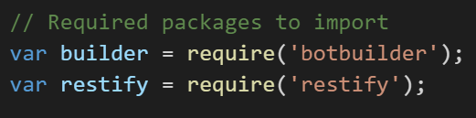
Setup - packages
Import the Bot Builder SDK package
Import “restify” to allow use to create the REST server for posting replies

Slide 100
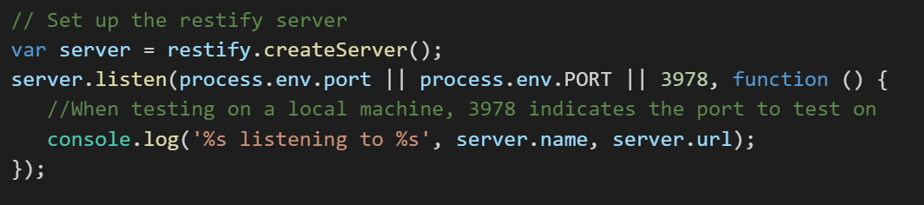
Setup –server
Set up the REST API server and set up message routing for the channel

Slide 101

Setup – connecting to the BF
Pull in the registered bot id and password
Create a chat connector
Set up the posting of replies from bot
Notes:
Hook up the ChatConnector using the registration information which hooks it up to the Bot Framework (technically what’s called the Bot Framework Connector) and set up a way for the bot to reply. Basically, we are setting up our REST API here with the restify server we just made.
App id and app password will remain empty during pre-deployed-bot local testing.

Slide 102

Setup – and finally create the bot
Initiate the bot with the chat connector object

Slide 103

Messaging and routing – quick view

Slide 104

Messaging and routing – in code
All user messages route first to the root dialog
Notes:
Nothing user-message specific happens here.

Slide 105

Conversation
In cases involving a conversation, the message activity gets passed to a dialog “root method” which handles the entire dialog process asynchronously (with “bot.dialog”)
“session” is our conversation model
“bot.dialog” is the dialog handler
Notes:
The dialog “root method” is called SendAsync in C# and it controls the following process:
Instantiate the required components.
Deserialize the dialog state (the dialog stack in the storage “bags” and each dialog's state)
Resume the conversation processes where the Bot decided to suspend and wait for a message.
Send the replies.
Serialize the updated dialog state and storage “bags” and persist it back to the state store.
Notes:
The dialog process can involve sub-dialogs
In between 2 and 3 a dialog object gets made and the message processed, possibly sub-dialogs spawned and further messages obtained from the user, message waiting occurs, dialog state updated, and more.

Slide 106
Conversations and their key features Overview
Notes:
Conversation – dialog or stack of dialogs handled by a model

Slide 107
Key feature types in each builder SDK
.NET SDK
IDialogContext
IDialog
Fluent chained dialogs or FormFlow
State stores
PromptDialog
Features
Conversation model
Conversation management
Conversation management over steps
Persistent state data
Wait for user input
Node.js SDK
Session
Dialog handlers
Waterfalls
State bags
Prompts
Both interact with the Connector Service and we will start with a discussion of this service.
Notes:
They may use different names and different implementations, but have essentially all of the same key features.

Slide 108
Conversation management Dialog handlers

Slide 109

Conversation exchange
Hello Micheleen Harris!
(The dialog is now suspended until there is a message from Micheleen, the user)…
hi
(The dialog is now resumed and the bot can call a child dialog or send a message back)…
Notes:
Bot Builder lets you break your bots’ conversation with a user into parts called dialogs. You can chain dialogs together to have sub-conversations with the user or to accomplish some micro task. node.js – prompts and even waterfalls are implemented internally as dialogs

Slide 110
UniversalBot
Manages all conversations between a bot and user(s)
Connectors
Proactive messaging
Notes:
https://docs.botframework.com/en-us/node/builder/chat/UniversalBot/#navtitle

Slide 111
Connecting the bot to a framework
Two methods
1) Connect to the local console (e.g. ConsoleConnector class)
2) Connect to the Bot Framework (or emulate it at least) (e.g. ChatConnector class)
Notes:
https://docs.botframework.com/en-us/node/builder/chat/UniversalBot/#connectors

Slide 112
Modes of message delivery
Two types
1) Reactive – in response to a user message (e.g. session.send())
2) Proactive – in response to some external event (e.g. bot.send() or bot.beginDialog())
Notes:
Reactive is most common method delivery. A “pull” bot. (We’ve seen this type of code earlier – it’s what we were doing)
But there’s the option of “pushing” a message to a user based on an external event like if a product has shipped or there’s a weather alert. We first need the “address” of the user so we can find them later.
https://docs.botframework.com/en-us/node/builder/chat/UniversalBot/#proactive-messaging

Slide 113


Starting conversations – the push bot
Options
1) You don’t need to wait for a reply (e.g. bot.send())
2) You do need to wait for a reply (e.g. bot.beginDialog())
* Notice, we are not dealing with the session, but rather the bot object
Are we waiting for a reply or not here?
Notes:
The differences between bot.send() and bot.beginDialog() are subtle.
Calling bot.send() with a message won’t affect the state of any existing conversation between the bot & user so it’s generally safe to call at any time.
Calling bot.beginDialog() will end any existing conversation between the bot & user and start a new conversation using the specified dialog.
As a general rule you should call bot.send() if you don’t need to wait for a reply from the user and bot.beginDialog()if you do.
https://docs.botframework.com/en-us/node/builder/chat/UniversalBot/#starting-conversations

Slide 114
Dialogs and handlers
Conversational exchange elements
Dialog object
Closure
Waterfalls
Prompts
other forms (e.g. graph extension as in bot-trees)
Notes:
Dialog object – conversational exchange object
Closure – passed in single functions to create a 1-step waterfall which loops
Waterfalls – conversational exchange over steps
other forms (e.g. graph extension as in bot-trees)

Slide 115
Dialog handler example
bot.dialog object handles the message
A child dialog is made
Notes:
To understand dialogs its easiest to think of them as the equivalent of routes for a website.
All bots will have at least one root ‘/’ dialog just like all websites typically have at least one root ‘/’ route.
When the framework receives a message from the user it will be routed to this root ‘/’ dialog for processing.
For many bots this single root ‘/’ dialog is all that’s needed but just like websites often have multiple routes, bots will often have multiple dialogs.
https://docs.botframework.com/en-us/node/builder/chat/dialogs/#overview

Slide 116

Closure
Single function (one-step “waterfall”)
Notes:
Here, no matter what the user’s message is, the bot will always return “Hello world”

Slide 117

Waterfall
The waterfall is an array of functions that chain together to form steps in a dialog
Notes:
By passing an array of functions for our dialog handler a waterfall is setup where the results of the first function are passed to the input of the second function. We can chain together a series of these functions into steps that create waterfalls of any length.
This code uses dialog data state “bag” to store some things. We didn’t’ have to do that, but it gave us a way to pass something from one dialog to the next in a temporary way.
What happens if we don’t have a built-in prompt in use? (Ans: we’ll need to call next() ourselves)

Slide 118

Waterfall example 1
Waterfalls are the most common form of dialogs
Notes:
Most common form of dialogs. Fundamental skill.
Bots based on Bot Builder implement something we call “Guided Dialog” meaning that the bot is generally driving (or guiding) the conversation with the user.
Calling a built-in prompt like Prompts.text() moves the conversation along because the users response to the prompt is passed to the input of the next waterfall step.
In .NET FormFlows are used.

Slide 119

Waterfall example 2
Many-step waterfall
Notes:
Most common form of dialogs. Fundamental skill.
Hello…What’s your name
Hi <results> How many years have you been coding?
“What language do you code Node using?”
etc.
https://docs.botframework.com/en-us/node/builder/chat/dialogs/#waterfall

Slide 120
Prompts
Use a prompt to wait and obtain user input.
Use a built-in prompt for expected types.
Notes:
To actually wait for the users input we’re using one of the SDK’s built in prompts. We’re using a simple text prompt which will capture anything the user types but the SDK has a wide range of built-in prompt types.

Slide 121


Built-in prompts in both SDKs
C#
Node.js
Notes:
my notes:
A “dialog factory” for simple prompts to make obtaining user input easier.

Slide 122



Graph dialog bot – a less linear conversation
Notes:
This is an extension that helps us do two things: 1) create a more flowing conversation by taking away the constraint that it must be linear as we’ve seen in waterfalls 2) allows us to load a preset “graph” or dialog flow from a data source like a file.
More at: https://www.microsoft.com/developerblog/real-life-code/2016/11/11/Bot-Graph-Dialog.html

Slide 123
Conversation model Sessions or contexts

Slide 124

Sessions
Session contains the stack of active dialogs
Sending messages
Dialog stack
Callbacks
Notes:
https://docs.botframework.com/en-us/node/builder/chat/session/#navtitle
Sending messages (text, attachments, cards, etc.)
Dialog stack (starting, ending, replacing, etc.)
Callbacks (usage)

Slide 125

Sending messages
A text message is easy. Just session.send() for example.
What’s more fun is sending attachments.
What type of attachment is being sent here?
Notes:
Attachments types allowed: image, video, and file

Slide 126



Sending messages cont’d
Cards – hero and thumbnail cards which can have text, images or buttons even
Build the message
Card as reply

Slide 127
Dialog lab
Building dialogs
Notes:
Follow the instructions in the code (server.js) for this sample bot: https://github.com/Azure/bot-education/tree/master/Student-Resources/BOTs/Node/bot-playground

Slide 128
Please let me know how things are going https://aka.ms/botedu-survey

Slide 129
Attachments and cards lab
Building a bot that sends an image attachment
Notes:
Add an image attachment and a hero card (fill in the proper code) for this bot: https://github.com/Azure/bot-education/tree/master/Student-Resources/BOTs/Node/bot-cardbot
You can check your code with Node code under Instructor-Resources at https://github.com/Azure/bot-education/tree/master/Instructor-Resources/BOTs/Node

Slide 130
State storage Managed State API and bags
Notes:
https://docs.botframework.com/en-us/node/builder/guides/core-concepts/#adding-dialogs-and-memory

Slide 131
State Service: types of bot data stored for us (part of Bot Connector)
User-conversation data
Conversation data
User data
Dialog data
This data is currently stored for free for you within the Bot Framework State Service.
However, you may bring in your own data source (format: key-value store)
Access with session object in Node
Notes:
User data – globally available for user across all conversations
conversation data – stores globally for a single conversation (many users could be involved)
User-conversation data – stores globally conversation data for a user (But private to just that user)
Dialog data as well – persists for a single dialog (helpful for temp data in a waterfall set of steps)
If I have a bot that plays Blackjack with me, my stats would be stored in user data (would follow me around from game to game), the deck information and stats in the conversation data (i.e. other players could use the same deck), and my hand in a game would be in user-conversation data (my immediate game’s data).
The dialog data persistence ensures that the dialogs state is properly maintained between each turn of the conversation. Dialog data also ensures that a conversation can be picked up later and even on a different machine.
Anything can be stored in these data stores or bags, however it should be limited to data types that are serializable like primitives.

Slide 132

Storage behind the scenes
Bring your own:
Key-Value based storage
Bot Framework state service:
Azure Table Storage
Notes:
The State REST API has wrappers built around Azure Table Storage. NB, you can bring your own storage in the form of a key-value store like Redis Cache, Table Storage etc. The Bot Framework manages this default storage for you so you can maintain a stateless bot experience and if you bring your own, you’ll need to maintain that store and make sure it scales.

Slide 133



Persistent state data
State storage, managed by State API
Also, called storage “bags”
Notes:
Remember our:
User data
Conversation data
Private conversation data
Dialog data

Slide 134
Additional elements Recognizers Localization Calling Extensions

Slide 135
Developer tip
Maintain code in staging spaces:
Local – Bot Framework connects to my local machine
Dev – push publicly and BF connects in cloud
Prod – what goes in Bot Directory; final product
Notes:
Local – e.g. in Node.js can use ngrok as a local server tunnel service (get a free account if wish to ngrok https://dashboard.ngrok.com/user/signup)

Slide 136
Intents lab part 1
Building a bot to handle user intents
Notes:
Follow instructions here: https://github.com/Azure/bot-education/tree/master/Student-Resources/BOTs/Node/bot-simpleintent
Advanced:
Can you deal with the date using Date datetime formats? See https://docs.botframework.com/en-us/node/builder/chat/IntentDialog/#resolving-dates--times

Slide 137
Adding intelligence to your bot

Slide 138

Microsoft Cognitive Services preview
Vision
From faces to feelings, allow your apps to understand images and video
Cognitive Services
Give your solutions a human side
Speech
Hear and speak to your users by filtering noise, identifying speakers, and understanding intent
Language
Process text and learn how to recognize what users want
Knowledge
Tap into rich knowledge amassed from the web, academia, or your own data
Search
Access billions of web pages, images, videos, and news with the power of Bing APIs
Notes:
What are Cognitive Services? Microsoft Cognitive Services are a new collection of intelligence and knowledge APIs that enable developers to ultimately build smarter apps.
So, what are Cognitive Services? Cognitive Services are a collection of artificial intelligence APIs, and we believe in democratizing artificial intelligence. So what that means is, regardless of your skill level -- whether you're a high school student running your first program or working in industry or in a giant enterprise -- that you should be able to use our APIs incredibly quickly in a matter of minutes.
And regardless of your platform -- whether you're on Android or IOS or Windows, or making a website -- all of our APIs are rest APIs, which means you can call them as long as you have an Internet connection. And so that's pretty huge because what we're doing is making it so that everyone can build these smarter, more context-aware applications.
The technology used in our APIs is the same technology that powers our products today. And so, when you think of things like the Bing search APIs, it's the same technology from Bing.
Today I’m going to talk with you about the entire collection spanning vision, speech, language, knowledge, and search.
The other things that I want to point out is that you can get started for free with all of the APIs, but we do have pricing available for a number of them, which are in public preview on Azure.
The other piece is the developer resources. So, all of our documentation is on the website and actually in GitHub as well, so we do welcome community submissions. We have a set of SDKs that are also available on GitHub where we welcome pull requests and post everything on there. The SDKs vary from API to API, but they are all included in this one repository for people to see.
And then we have three different communities that we support. We have our MSDN forums, our Stack Overflow, and we have User Voice that we use for feedback requests.

Slide 139
Microsoft Cognitive Services preview
Vision
Computer Vision | Emotion | Face | Video | Content Moderator
Cognitive Services
Give your solutions a human side
Speech
Custom Recognition | Speaker Recognition | Speech
Language
Bing Spell Check | Language Understanding | Linguistic Analysis | Text Analytics | Web Language Model | Translator Text and Speech
Knowledge
Academic Knowledge | Entity Linking | QnA Maker Knowledge Exploration | Recommendations
Search
Bing Auto Suggest | Bing Image Search | Bing News Search | Bing Video Search | Bing Web Search
Notes:
At Microsoft, we’ve been offering APIs for a very long time across the company. In delivering Microsoft Cognitive Services API, we started with 4 last year at /build (2015); added 7 more last December, and today we have 25 APIs in our collection.
Cognitive Services are available individually or as a part of the Cortana Intelligence Suite, formerly known as Cortana Analytics, which provides a comprehensive collection of services powered by cutting-edge research into machine learning, perception, analytics and social bots.
These APIs are powered by Microsoft Azure.
Developers and businesses can use this suite of services and tools to create apps that learn about our world and interact with people and customers in personalized, intelligent ways.

Slide 140

Leveraging the API collection
Any of the Cognitive Services APIs can be reached with a simple REST API call
Notes:
Language integration with LUIS (for NLP based in intents) is easiest as a NuGet package exists within the bot builder for easy integration, however any of the Cognitive Services APIs can be reached with a simple REST API call.
Next, let’s go straight to an example of implementing a Cognitive Service API (LUIS) within a bot

Slide 141
Intents lab part 2
Building a bot with language understanding
Notes:
Follow the instructions and use the resources here: https://github.com/Microsoft/BotBuilder-Samples/tree/master/Node/intelligence-LUIS
Good docs at https://docs.botframework.com/en-us/node/builder/guides/understanding-natural-language/#luis

Slide 142
Rate this tutorial!
https://aka.ms/botedu-survey

Slide 143
Non-linear waterfall lab
Leveraging the bot-trees graph bot
Notes:
https://github.com/CatalystCode/bot-trees (follow instructions to install extension – this will be part of the Bot Framework in the future)
If you have some extra time try out the Azure Bot Service (https://docs.botframework.com/en-us/azure-bot-service/). Set the bot here or another one up for fun as an Azure Bot Service (use the echobot for instance as a template and then host the code for continuous deployment on GitHub and pulled in to Azure) – basically replace the “template” code given by Azure Bot Service with custom code while retaining the structure.

Slide 144
Resources
Github issues
Gitter
Stackoverflow with botframework tag (#botframework)
Notes:
https://github.com/Microsoft/BotBuilder/issues
https://gitter.im/Microsoft/BotBuilder
http://stackoverflow.com/questions/tagged/botframework

Slide 145
Questions?
Also, try the course gitter chatroom at aka.ms/botedu-discuss

Slide 146
Hack

Slide 147
Welcome to the hackathon
https://aka.ms/botedu-hack
Notes:
https://aka.ms/botedu-hack

Slide 148
Developing and Deploying Intelligent Chat Bots
Day 2
Q and A

Slide 149
Extras

Slide 150
Hackathon schedule
Proposal (30 min): As a team come up with a concrete flow diagram to communicate the components and ideas involved in your proposal. Present your proposal in 2 minutes or less.
Implement idea using C#, Node.js or leverage the REST API.
Presentations (4:30pm): 4 minute showcase of your implementation (simply what you got done and future plans if need-be)
Notes:
Example bot project: https://azure.microsoft.com/en-us/blog/bot-framework-made-better-with-azure/

Slide 151
Example scenario for Q&A bot
“I want to automate my helpdesk…”
What is the most repetitive or takes the most of my employees’ time…
Password reset
Opening a ticket
Request to install software

Slide 152
Q&A Example: the problem / the solution
Building an end to end AI based helpdesk: Very hard
Building bots that automate those simple tasks: Very easy
Notes:
So focus on the easy: Narrow down scenarios to tangible things, often repetitive tasks.
If you can see an app doing it, then you can see a bot doing it, too.

Slide 153
Hack Topic 1
Our current expectation is that we will address one or more of the primary challenges in managing humanitarian and medical assistance to the refugees from the Middle East and North Africa (MENA).​ There is a lack of data for NGOs on the ground working with refugees in Europe & the middle east. Technology could help document the crisis, help NGOs work together and solicit further support. Technical & marketing solutions are needed to evangelize and mobilize volunteers and donors. Procurement for in-kind donations is sporadic and disorganized. Technology solutions could be utilized to build efficiencies in sourcing of humanitarian goods and resources for missions. Awareness for this humanitarian crisis low and there is a need for community dialog and empathy.

Slide 154
Hack Topic 2
The goal is to address the essential education and enrichment needs of kids in foster care. An organization has been working with kids in foster care to help them secure essential education, basic needs and social experiences they deserve. ​We would like to develop a digital solution that will allow foster kids to transcribe their aspirations and goals, work with their mentors to create a plan to achieve them, and to keep track of their progress and achievements through continuous communication and feedback from their advisors.​​

Slide 155
Hack Topic 3
We need to create a communications app for non-verbal/emerging verbal kids in K-12 education. Currently Apple occupies this niche by default, but there has never been a true grounds-up effort to adapt existing technology (GPS, speech recognition, word banks, etc.) & marry it to a visual communications app to be a truly effective communications tools for so many kids in need. In essence this app can give a child a ‘voice’ and help them integrate into their communities and immensely improve their quality of life.​​

Slide 156

.NET SDK: NuGet packages galore for Cognitive Services
Cognitive services (aka ProjectOxford)
And many, many more – Connector and everything the .NET framework provides

Slide 157
Design Principles

Slide 158

Initial prompt
People do not know what the bot can do.
If they can ask a silly question, they will.
Provide a prompt.

Slide 159

UI IS A DIALOG STACK
Root dialog is the first one
Root redirects to following dialog
Current dialog is always on top of stack
Every message is processed by top dialog until closed or redirected
Closed dialog returns control to previous one
BUT people do not think in stacks

Slide 160
Stack navigation tips
The user may interrupt the stack navigation at any point
Limit number of retry attempts for each question
Implement global message handlers for common keywords (e.g. help, cancel, restart, exit)
Users are impatient
Acknowledge input, even just with a “thinking…” message or notification
Provide useful information
“thinking…” is ok. “Evaluating keyword 234 out of 1M” is redundant.
Users have short memory
Keep to the current topic / keyword, unless the user wants to switch explicitly (e.g. with message “change topic to”)

Slide 161
Patterns
Task Automation
Knowledge base (combining QnA Maker, Search)
Handoff to human
More on docs.microsoft.com/en-us/bot-framework

